Slide 1
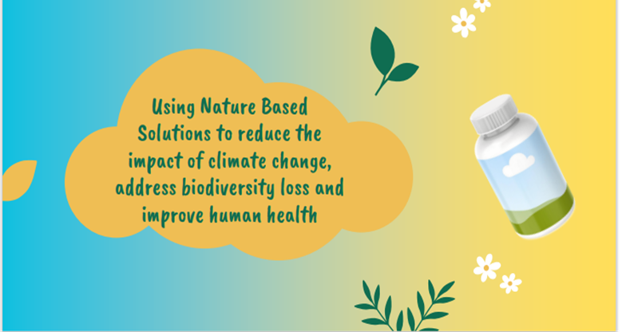

UNESCO UK Commission Shared Outcomes Pilot Project Climate Adaptation, Natural Heritage and Health

Slide 2
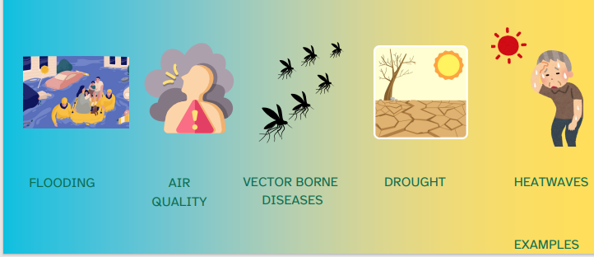
We know climate change will impact North Devon

Slide 3
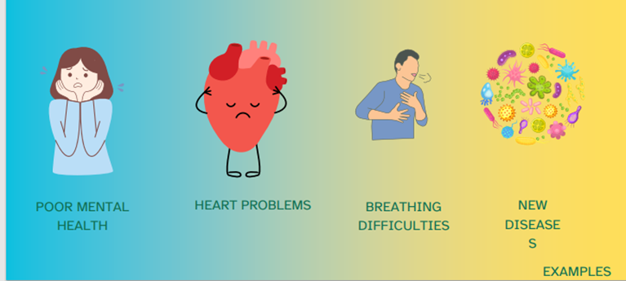
…and could lead to illness and poor health

Slide 4
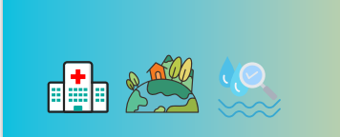
UNESCO UK Commission Shared Outcomes Pilot Project Identifying where nature-based climate change mitigation projects could help protect vulnerable people in North Devon for the future
July 2024 - July 2025
Gain improved understanding of local climate threats to local health
Create data platform to identify nature-based opportunities to protect health and natural heritage
Outline a collaborative working framework
Contribute to climate related short-term health warning mechanisms
Supported by data and engagement agencies via UNESCO

Slide 5
We would be grateful for your support please
Representative from One Northern Devon on Shared Outcomes Project Monthly Steering Group
Participation in data and threat analysis surveys
2 workshops over the next 6 months
Input into design of a data tool

Slide 6
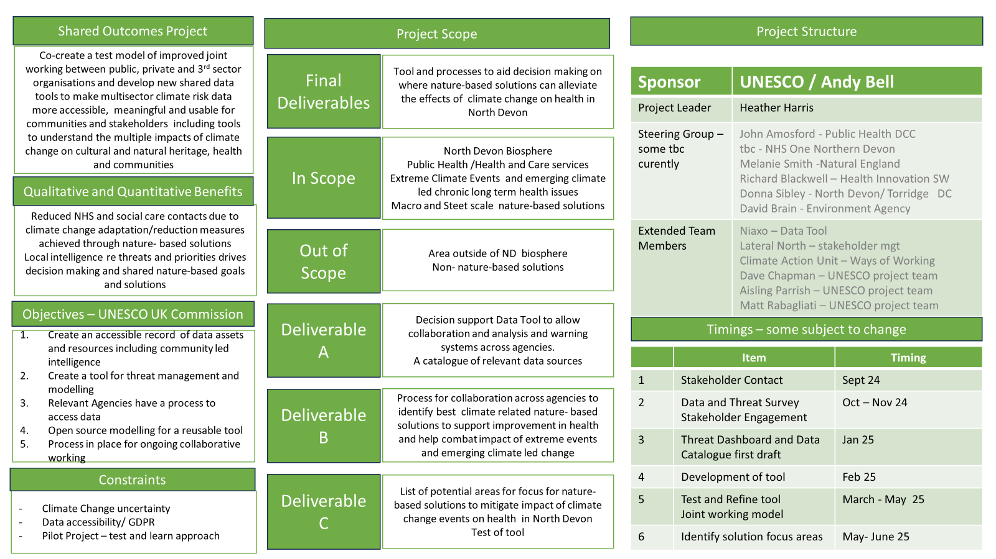
Further Detail Project Charter
Please contact heather.harris@devon.gov.uk for further information

