Slide 1

Joint Northern Local Care Partnership and One Northern Devon Board Development Session & Outputs
19th December 2023
Dr Phil Bardzil

Slide 2
Aims & Objectives:
Set the foundations for a new single entity with shared vision and values
Agree how we work together by coalescing around a shared topic
Bring the 2 workplans together, remove duplication and agree new set of priorities
Practice working / decision making together

Slide 3

Agenda:
Introductions
Getting to know one another - icebreaker
Agreeing ways of working together
Exploring a shared topic – structured exercise
Applying learning to the new partnership – discussion
Agreeing actions and priorities to take forward

Slide 4
Ways of Working
Psychological Contract:
Agreeing and aligning our expectations, beliefs, ambitions, behaviours
and obligations
Psychological Safety:
Ensuring we all feel free to voice our opinions, ideas
and reasonable challenges and show willingness to
consider those of others
Discussion to explore and agree ideological, behavioural
and relational principles to guide our ways of working

Slide 5
Ways of Working Discussion
Curiosity
Profit/commercial curiosity
Transparency
Addressing conflicts of interest
Openness
Sharing ideas
Respect (and respect differences)
Understanding
Experimentation
Pragmatism
Risk taking and opportunism
Ambition
Agreed framework/process/structure
Informal contact/relationships
Continuing development
Genuine representation in mediating on behalf of our own organisations
Leadership
Role Modelling
Shared purpose and alignment
Focusing on outcomes
Inclusion
Action:
Condense these contributions into key points for agreement

Slide 6
…Additional thoughts
Suspend obligations and responsibilities and explore grey areas where we can coalesce and work together
Come out with a mutual understanding of what we expect from one another on the board
Deliverable – engaging properly with private sector to access funding
Add public service to the ways of working, making space for both reflectors and pragmatists
Comment on ‘health and social care dominating’ – we need to link this to North Devon Futures and where our two partnerships sit side by side

Slide 7
Ways of Working
Assertive
(Voice)
DEMANDING
COLLABORATING
(I’M RIGHT / YOU’RE WRONG)
Domination
Blame Culture
(WIN / WIN)
Trust
Culture of Inclusion
Adaptive
(Emotion Regulation)
AVOIDING
ACCOMMODATING
(IT’S ALL WRONG)
Neglect
Culture of Obstruction
(YOU’RE RIGHT / I’M WRONG)
Appeasement
Culture of Conformity

Slide 8
Mindset
Exert Power
Concede Power

Slide 9
Main Exercise: Focus
Building relationships and a collaborative leadership perspective
How to work together and What to think about
“Putting the Horse before the Cart”
The Horse is How we work
The Cart contains the What
we are working on……..

Slide 10
The WHAT: Chosen Topic
Topic Options | Votes | Priority Votes | Outcomes
1. Flow/HIU | 5 | 1,1,2,3, 1 | 1
2. One Communities/Community Development via the JFP | 4 | 2,3,1, 3 | 2
3. Children & YP | 3 | 3,1,2
4. Hospital Discharge +/- Winter Pressures | 1 | 2
5. Mental Health | 4 | 2,3,2,2 | 3
6. The Environment | 2 | 1,3
7. Housing | 3 | 3,1,2
8. Economic Development | 2 | 3,1

Slide 11
The WHAT: Chosen Topic
We are centred around what matters to the person
We take a ‘Team around the Person’ approach
We offer case worker support
We coordinate services so that they ‘flow’ around the person, rather than them ‘bouncing around the system’
We challenge the system and drive change by highlighting gaps and failures that increase ‘failure demand’
Are we all agreed on these principles?

Slide 12
Discussion Exercise
Divide into x groups and generate an empathy map for a chosen HIU proxy individual/group/sector
Consider their experience of engaging with the system – from their perspective
Consider this in terms of One North Devon / LCP (rather than your own organisation)
Use this to identify where and how One North Devon can work differently to lead and improve flow:
What already works well
What would be ‘even better if’
How can people be better supported
Bring findings, observations and suggestions for improvement to plenary discussion
Notes:
How would things be better from the person’s point of view
What leadership is needed so that things work better
What is our role as a partnership to ensure system change?
(changes needed: understanding what matters, joining up around what matters, doing only and always what matters)

Slide 13
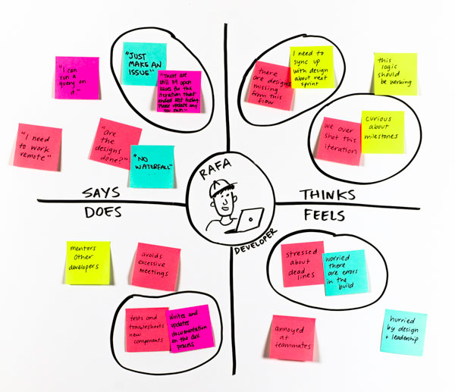
Empathy Mapping
What does it feel like to be on the receiving end of us (as a system)?
What do they SEE?
What is their environment and community like?
What surrounds them?
How might they see us?
What do they HEAR?
How does their environment influence them?
Who really influences them and how?
What do they hear from/about us?
What do they THINK and FEEL?
What goes on in their minds?
What is important/matters to them?
What do they actually DO or EXPECT?
What really happens?
What do they get/give?
What do they do for each other?

Slide 14
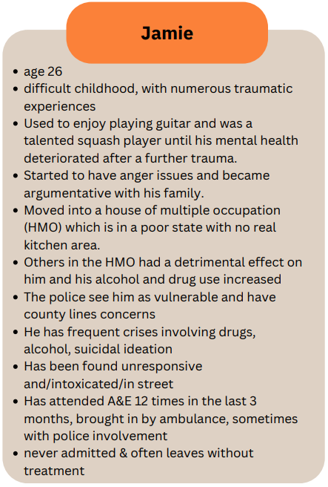
OND Flow Case Study - Jamie
‘As is’
What we’d like it to be
Feel
Confused
Suicidal
Lost
Vulnerable
Misunderstood
Low self-esteem
Alcohol is a solution
Angry and afraid
Isolated and neglected
Low aspiration
Trauma
See
Alcohol and drugs
Criminality
People with similar issues
Sustainable and consistent support
Compassion from community
Employment and training
Connection
Trauma informed
Sage
Empathy
Sense of belonging
‘I can contribute’
Hear
What is the right help?
‘I’m a problem’
‘I am valued’
‘I am safe’
Positivity
We all work together
Expect
Nothing
Rejection
Support to stop
Not to be trusted
Unlikely to seek further help
To get worse
Inaccessible support
Coordinated response
Earlier support
Self-directed, able to navigate
A pooled-budget
Practical solutions

Slide 15
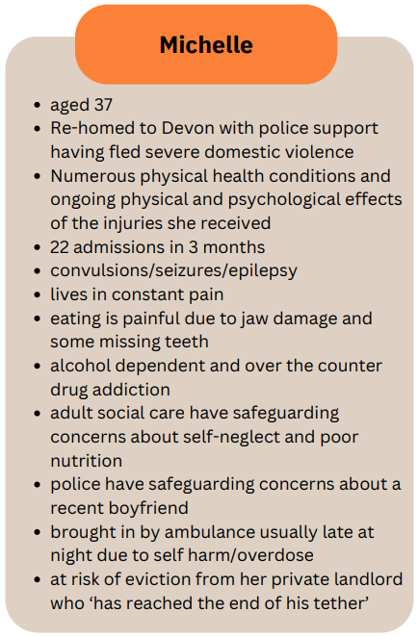
OND Flow Case Study - Michelle
‘As is’
Feel/Think
No consistence aims
No future
No joined up support
Pain and stress
Distress
Coached to support herself to be in control
Autonomy and power
Pulling in support as needed
Contained and confident about support
Respected
Supported
What we’d like it to be
See/Do
Too busy for me/no time
Lots of others with same issue
Repeating themselves
No route causes
Rejected
Advocacy
No longer in ED
Eviction avoidance goals
Network of support
Michelle in the room
Hear
‘Oh no, not you again’
Self-inflicted
Non-medical
More trauma
Gap between presentation and root causes
What matters to you
What do you need
Why are you here – root cause
Expect
Inaccessible support
Stigma
Judgement
In trouble
Sagely and care
Alternative agendas
People who understand
Shared language
Joint understanding of partners supporting
Sharing information

Slide 16
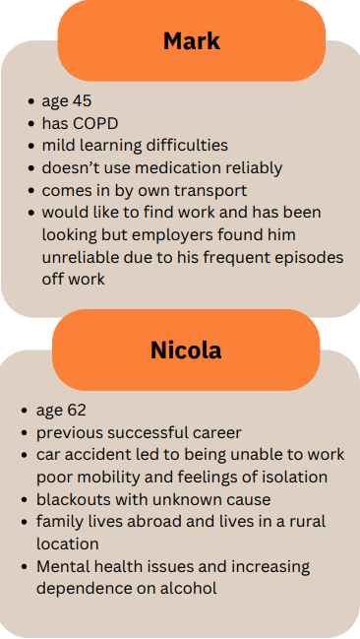
OND Flow Case Study – Mark/Nicola
‘As is’
Feels
Isolation
Lack of purpose and value
Judged
Lonely
Overwhelmed
Abandoned
Embarrassed/stigmatised
Shame
See
How can I take the next step?
I want choice
I want opportunities
Why me?
What isn’t said?
Does
Own transport
Has a lack of resilience
Isolates themselves
Resistance to change
Unhealthy coping mechanisms
Focussing on the negatives
Calling for help/attention
Thinks
It’s only happening to me
Services don’t care or understand
How to balance social vs privacy
Money worries
I don’t have the tools

Slide 17
How One Northern Devon can work differently to lead and improve Flow
What went well | Even better if
‘What matters to me’ conversation Desire to work together We know what we have done, what the outcomes are and measure this Community connection Team around the person (TAP) meetings | Funding to expand and grow (recurrent) To measure the ‘ripple effect’ on people around them Move up-stream to use same approach in a more preventative context Time commitments Improve and enhance community connected Use principles of High Flow in other groups/issues/partner agencies
How people can be better supported
Get in there much earlier – work with children and families to prevent HIU in the future Grow community resources to wrap around people i.e. community development Mentorship for individuals and families VCSE to understand themes and gaps and to use OND/LCP to mobilise community resources and channel investment

Slide 18
Actions and Outcomes
Refine ways of working discussion to capture principles in a meaningful way
Mapping exercise across priorities re existing Flow approaches
Exercise to map out where ‘High Flow’ activity takes place, mapping out a coordinated network ‘wrapping the team around the person’
Evaluate High Flow – KPIs?
Members to provide feedback for the joint meeting via this link by the 19th of January: https://forms.office.com/e/1JimhDKft2

