Slide 1

Considerations for the One Northern Devon LCP governance
Membership must reflect function – strategy vs ‘doing’ and delivery
Levels – steering/workstreams – overview/programme – strategic/board
Consider the Devon Health and Wellbeing Board model * and how we as an LCP link in
Consider the North Devon Futures model ** and how we as an LCP link in
How will we devolve funds?
Strategic/Board level membership:
One representative per organisation, or clear justification for more than one representative, understanding we can bring people in for specific items where necessary
Organisation/Sector
NHS Devon ICB Devon Partnership Trust Devon County Council & Public Health Business Sector Police Local Council North Devon Homes Active Devon Voluntary and Community Sector RDUH Primary Care Administration ?Elected members Education
* More details here: Committee details - Health and Wellbeing Board - Democracy in Devon
**More details here: 7a - Appendix 1 Northern Devon Futures Proposals FINAL.pdf (torridge.gov.uk) (older version whilst new draft being signed off within NDF)

Slide 2
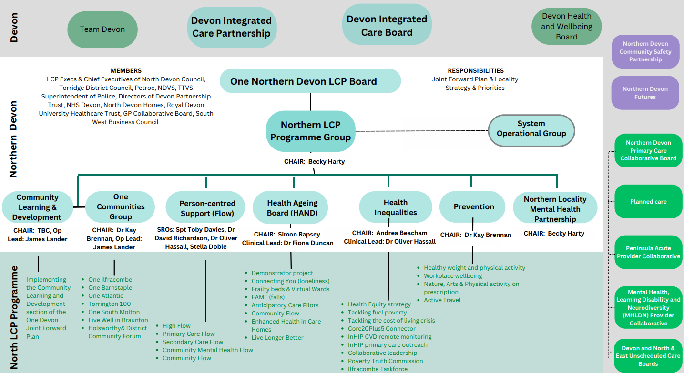
Current Northern Devon Local Care Partnership Governance

Slide 3
Describing the levels of function within our governance
For visual purposes only, not an organigram proposal
An example of one of the workstream groups that deliver the work programme of the Board e.g. implementation of the Joint Forward Plan workstream in Northern Devon .
Newly formed Board at executive level. Sets strategic direction for LCP in alignment with national and local priorities. Oversight of the work programme. Makes decisions.
One Communities Group
Programme Group
Community Development and Learning Group
Planning Group
Supports the Board to function and the development of the Board
Prevention
OND Board
Person-centred Support (FLOW)
The coordination function of the Board, holds the workplan for OND and the workstreams to account, communication channel between the Board and the workstreams. Attended by the Workstream Chairs.
Health Inequalities
Healthy Ageing Board (HAND)
Mental Health Partnership
Northern Devon Futures
Partnership meetings/ organisations that interface with the One Northern Devon LCP or specific workstreams.
North and East Unscheduled Care Board
Northern Devon Primary Care Collaborative Board
Northern System Operations Group

Slide 4
OND Board
Representation at executive/senior level.
Sets strategic direction for the Local Care Partnership in alignment with national and local priorities against the agreed vision and objectives of OND.
Oversight and accountability for the delivery of the work programme.
Each of the constituent parts of OND through the individuals representing their organisation, have delegated decision-making authority on behalf of their organisation via their internal scheme of delegation.
Prior to delegated funding from the ICB to LCP's, the Board will make proposals to the ICB or any other relevant organisation for the appropriate apportionment of funding at a local level e.g. HI & P allocation.
Can make financial decisions but must be in accordance with the financial standing regulations of the funding organisation.
Cannot hold funds as not a legal entity.

Slide 5
Programme Group
Coordination function of the Board.
Holds the overarching OND workplan.
Holds the workstream leads to account to deliver the work plan.
Highlights risks, issues, challenges and opportunities.
The work of the group is a standing items on the Board agenda.
Communication channel between the Board and the workstreams.
Supports the multiple workstreams to reduce duplication and maximise the opportunity to share ideas and good practice.
This group does not have delegated decision-making authority but can make recommendations to the OND Board.
Meets monthly
Membership: Chair TBC, Workstream Lead Chairs (Andrea Beacham, Kay Brennan, David Richardson, Oliver Hassell, Tara Rundle), supported by Beth Harris.
Opportunity for members of the current programme group to join a workstream or participate in the Programme Group.

Slide 6
Planning Group
Organises and administers the Board.
Enables the Board to function e.g. room bookings, invitations etc.
Sets Board agenda.
Develops the Board forward plan.
Horizon-scans for any issues/ opportunities and future-proofing.
Inducts new members / partnership building.
Communication strategies.
Plans and organises Board development.
Enables Board communication between formal meetings.
Opportunity for non health/social care partners to bring topics for pre-discussion.
Meets twice monthly.
Membership: Chaired by Lou Higgins (OND Chair), Andrea Beacham, Becky Harty, Beth Harris and Gemma Nield

Slide 7
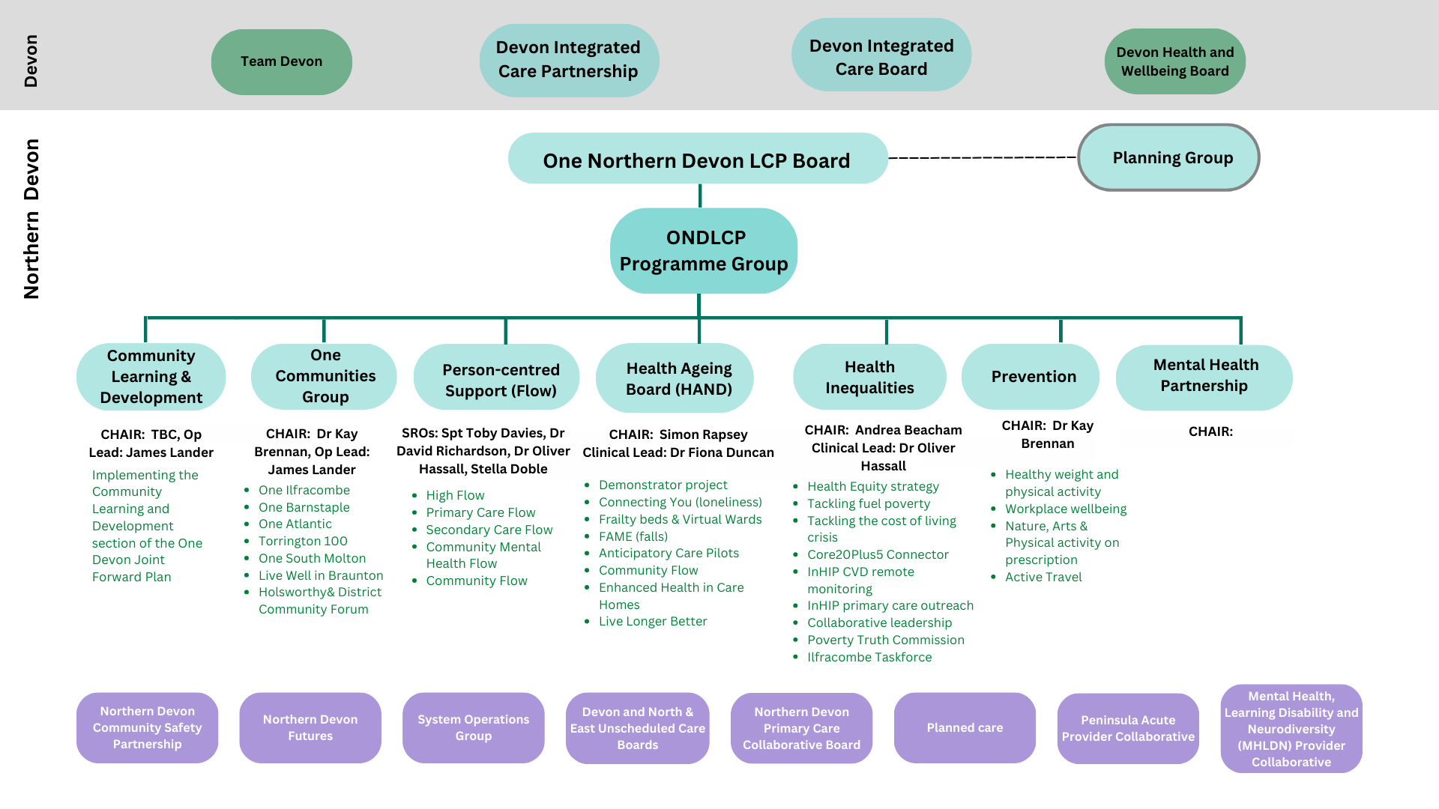
Proposed ONDLCP Governance

