Slide 1

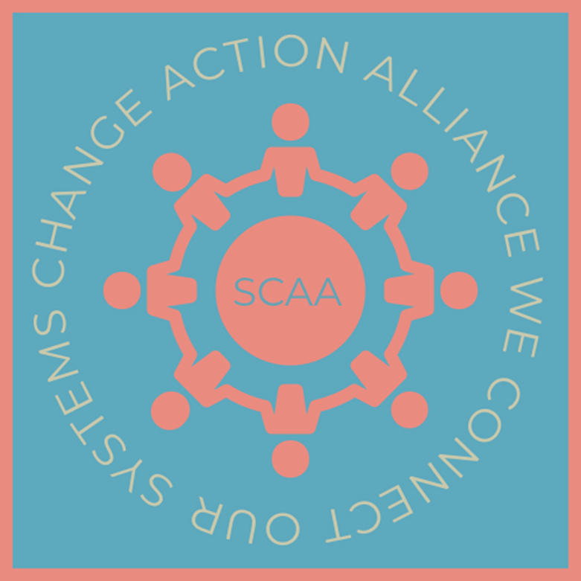


SYSTEM CHANGE ACTION ALLIANCE
HUMAN LEARNING SYSTEM
TUESDAY 29TH OCTOBER
NIKKI FULLER, LIZ CIRASUOLO, JOHN STAMMERS & CLAIRE FISHER
Creating a safe space for learning and action for people with complex needs through a collaboration model
www.scaadevon.org
Notes:
Claire to introduce the SCAA team

Slide 2

LEARNING AND BEING GUIDED BY THOSE WITH LIVED EXPERIENCE
The real voices
www.scaadevon.org
Notes:
John Stammers

Slide 3

SCAA - LCP - MARMM
Human Element
MARMM, System Stories, TAP
MARMM signed mandate -IG
Safeguarding/TAP
SCAA System Stories - PMSCC
Voice of Lived Experience - Consent led
www.scaadevon.org
Notes:
Claire

Slide 4

SCAA Offer to the System
Define the Culture
Journey Mapping
Learning Element
No blame, judgement
Journey Mapping
System coming together to map the journey of the client/patient
System Conditions
System Pressures
What we know
What questions still need answering
Creating Safety
www.scaadevon.org
Notes:
Claire

Slide 5
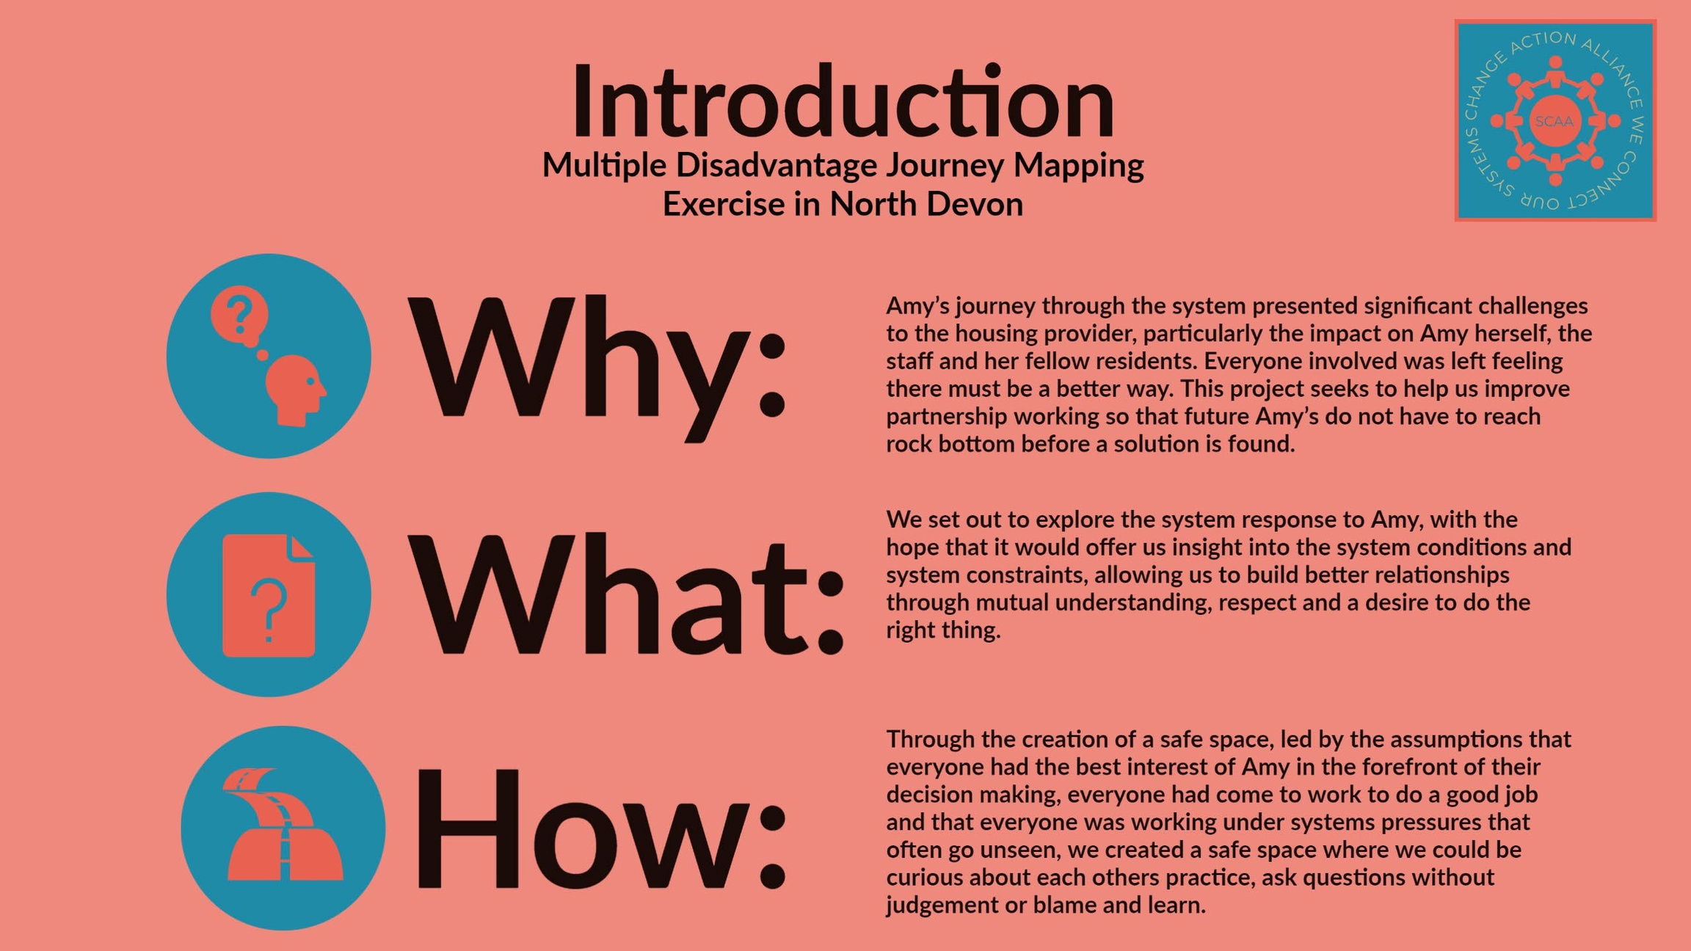

Slide 6
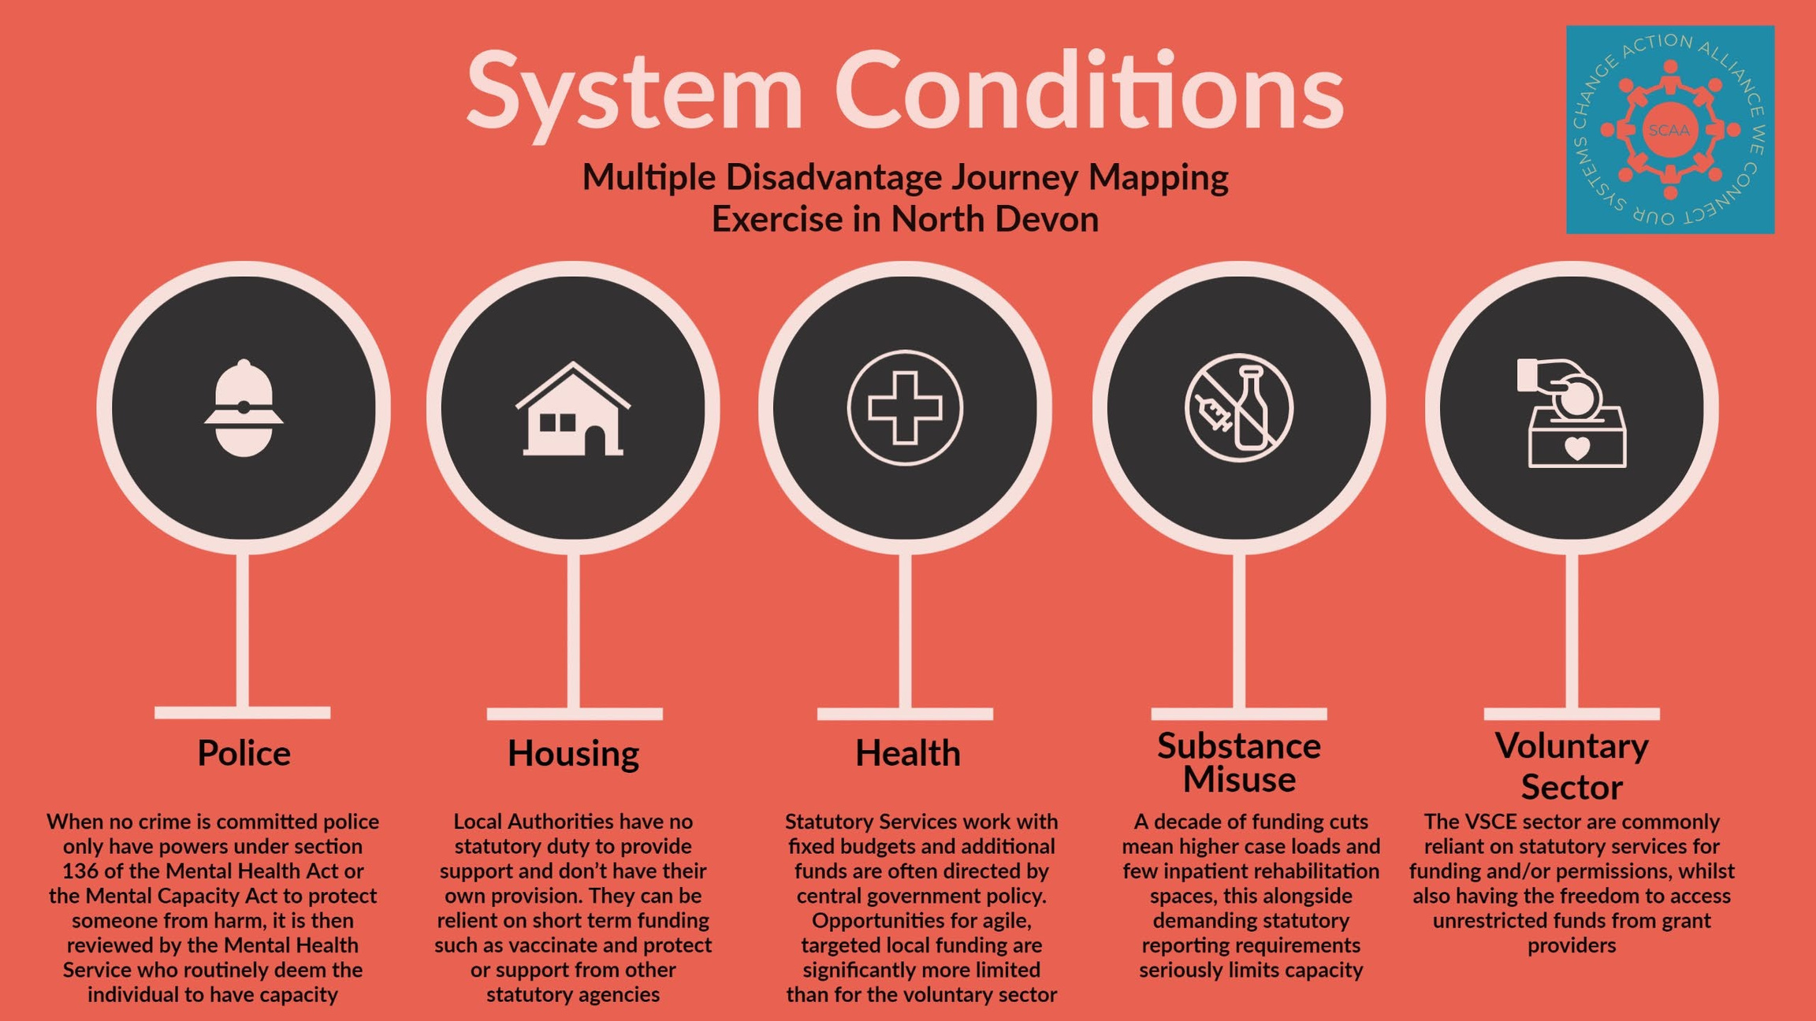

Slide 7
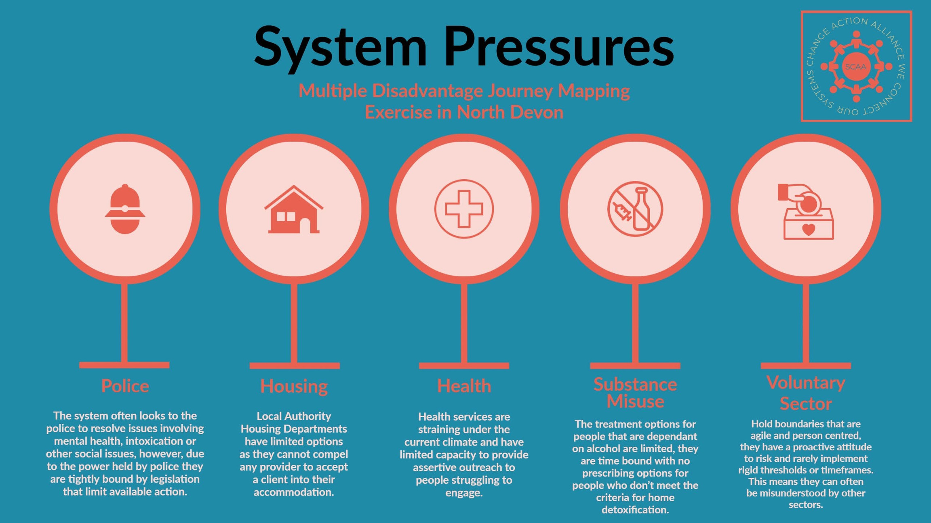

Slide 8
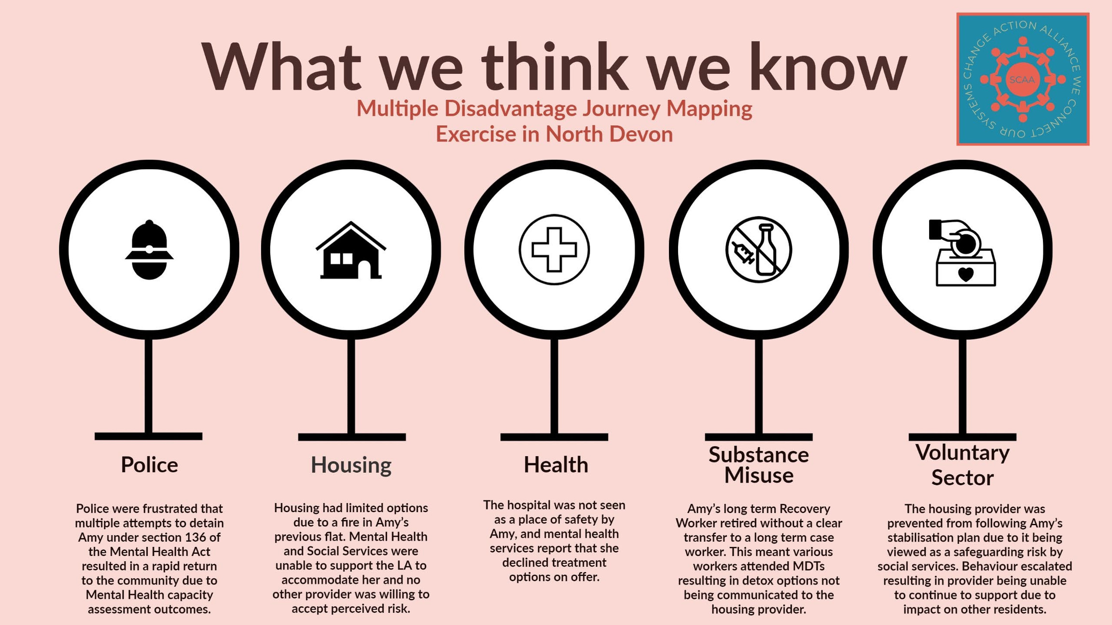

Slide 9
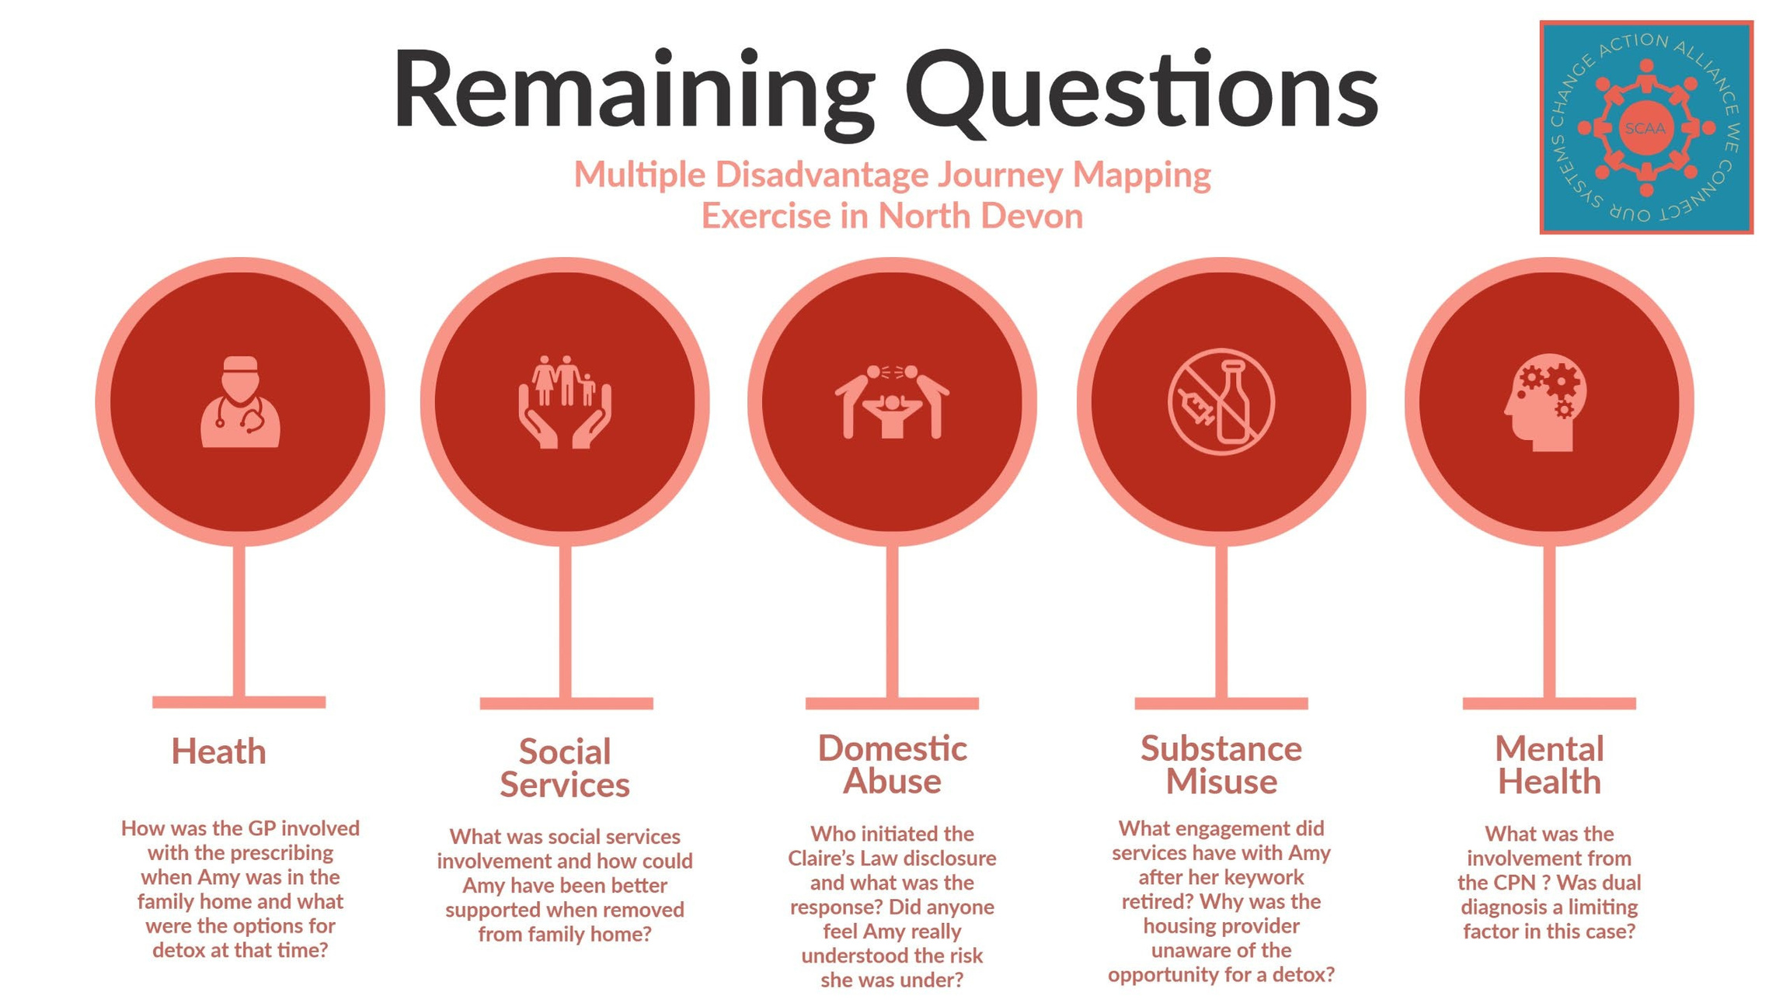

Slide 10
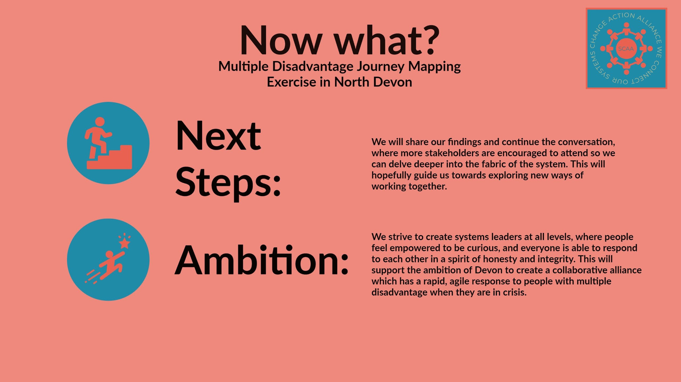

Slide 11






Potential impact - Brave Spaces
Humanity - Relationships - Collaboration - Learning - System
Lucy’s Journey
Test & Learn concept
Prototype Development
Start prototype
Listen
&
Reflect
Deliver prototype
Discussion
&
Negotiation
Relationship strengthening
Collective test
& learn
Extract system learning
Consolidate concept
Commissioned new service
To be continued
Zoom out
&
reframe
Translate
www.scaadevon.org
Notes:
Liz

Slide 12
SYSTEM CHANGE ACTION ALLIANCE
HUMAN LEARNING SYSTEM
SCAA - LCP - MARMM
Creating a safe space for learning and action for people with complex needs through a collaboration model
SCAA Offer to the system
Creating an action plan of learning
SCAA support to test and learn
SCAA resources; peer researcher
Linking organisations together for better outcomes
www.scaadevon.org
Notes:
Liz

Slide 13

SYSTEM CHANGE ACTION ALLIANCE
HUMAN LEARNING SYSTEM
SCAA - LCP - MARMM
Creating a safe space for learning and action for people with complex needs through a collaboration model
System Action
test and learn new system approaches
Prototyping
Sharing best practice across the system
www.scaadevon.org
Notes:
Liz

