Slide 1
Roadmap for Devon’s Neighbourhood Health Services
Lou Higgins
May 2025

Slide 2
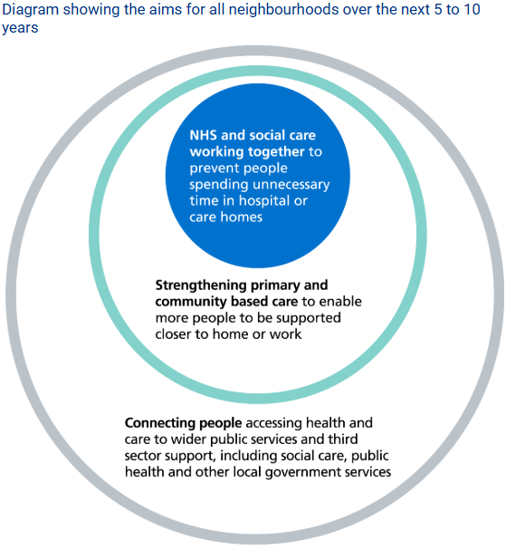
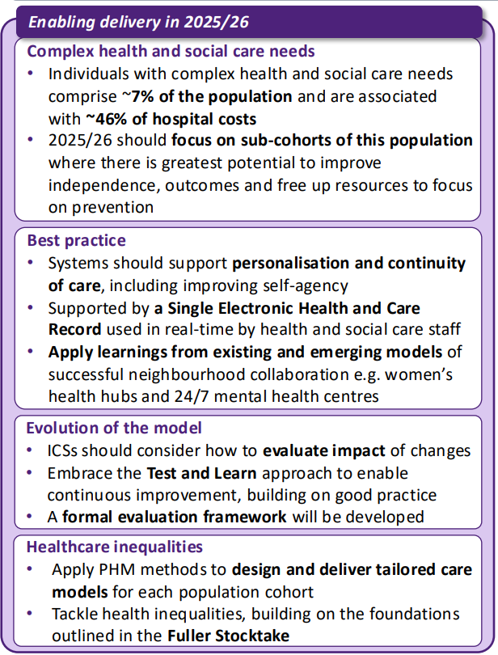

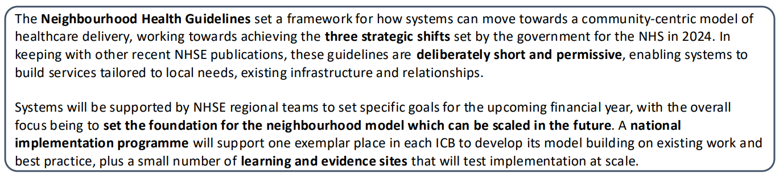
NHSE Neighbourhood Guidelines for 2025/2026
NHS England Neighbourhood Health Guidelines 2025-26 outline a new framework for community-centred care
Notes:
Barriers:
Fragmented systems and siloed working.
Limited resources and funding constraints.
NHS England highlights lack of integrated digital infrastructure.
Difficulty in measuring impact.
Key Successes: Increased accessibility, proactive patient management, better health outcomes.
Lessons Learned: Importance of data sharing, workforce alignment, and patient-centred care.

Slide 3
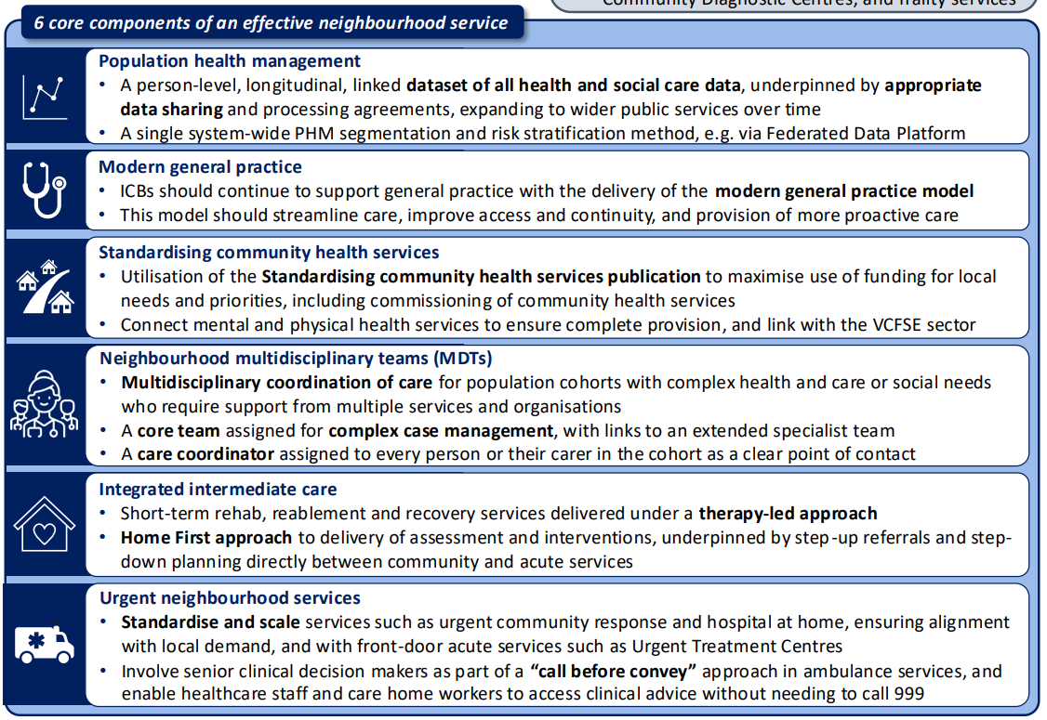

Slide 4
Roadmap for Devon’s Neighbourhood Health Services
This roadmap for the development of neighbourhood health services is written to guide NHS Devon in the establishment of a cornerstone of the NHS 10-year plan as described in the operating guidance for 25/26: NHS England » Neighbourhood health guidelines 2025/26
It is important that the strategy itself and model of delivery, is codesigned with providers, Local Care Partnerships (LCP’s) and the people who use our services and their carers.
In order to develop the neighbourhood footprint map, the following must apply:
  Neighbourhoods should cover about 50,000 population (welcome LCPs thoughts on this in terms of the population size)
  Neighbourhoods should be contiguous (no gaps between them)
  It must be very easy to determine which neighbourhood any individual “belongs to”
  Neighbourhoods will be supported by an MDT focused on personalisation and continuity

Slide 5
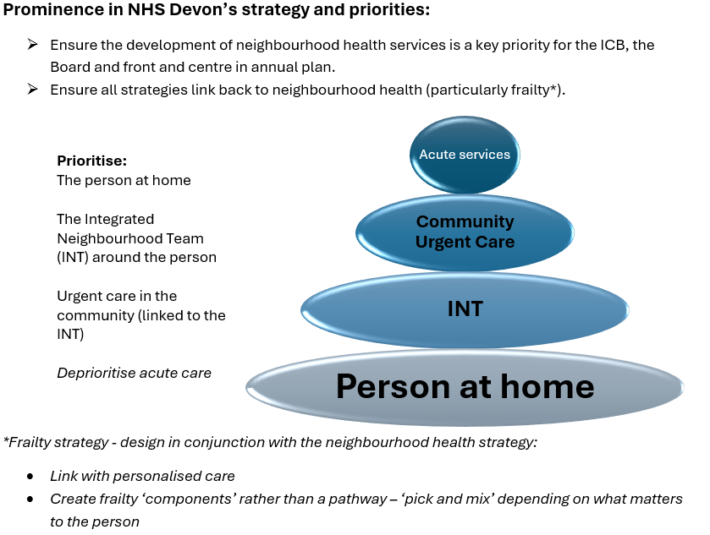
Roadmap 1: Prominence in NHS Devon’s strategy and priorities

Slide 6
Roadmap 2: Use Integrated Neighbourhood Teams (INTs) as the key function for developing and delivering neighbourhood health
Map Devon on geography, natural communities and Primary Care Networks (PCNs)
Agree the number and footprint of each neighbourhood
Agree any core strategic principals and outcome expectations
Develop an INT (Integrated Neighbourhood Team) for each neighbourhood
Segment the neighbourhoods into thirds
Create a delivery plan to span 3 years, with a third of neighbourhoods to be developed in each year
Pilot a different sub-cohort of the 7% in each test neighbourhood in 1st wave/phase e.g. most deprived, most frail elderly, Children and Young People (CYP) etc.
Target ICB resource to the development* and maturity of the INTs within each year, learn, review, establish impact (metrics to be agreed)
Reset plan for following year
*see next slide

Slide 7
Roadmap 2: Use Integrated Neighbourhood Teams (INTs) as the key function for developing and delivering neighbourhood health
*Development will need to include:
Relationship building between core members of INT (H&SC community team, GPs, VCSE and other). +/- restructure of current teams’ configurations and management/leadership.
Front-load BI support to INTs to establish baseline metrics
Embedding of Brave AI as the PH and risk stratification tool for all INTs
Proactive and preventative approach to population need aligned to the personalised care model
Establishing clear processes with urgent care in the community
Create culture akin to ‘never events’ in relation to avoidable ED attendance (acute should only be accessed for problems such as sepsis, CVE, MI and trauma – INTs and community urgent care needs to be able to deliver services that support the management of all other problems) and discharge conversion to long-term care (right-sized D2A response from INT, establishing a ‘pull’ model to proactively bring their resident back to their neighbourhood with the key driver of reducing length of stay (LoS) for their neighbourhood)

Slide 8
Roadmap 2: INT KPIs
Each neighbourhood responsible for their own KPIs (including targets), to include (not exhaustive):
  Patient experience measures (eg. Satisfaction with care coordination and communication)
  Time to first contact/response from referral
  Average time to complete care assessment
  Out-of-hours support availability
  Number of referrals to UCR from the INTs
  Number of referrals to community virtual wards from the INTs
  Number of admissions (from neighbourhood)
  LoS in acute (from neighbourhood)
  LoS in discharge pathway (from neighbourhood)
  Number of conversions to long-term care (from neighbourhoods)
  Frequency of MDT meetings
  Reduction in duplication of services
  Falls reduction rate

Slide 9
Roadmap 3: Use neighbourhoods to develop and enhance community urgent care offer
Same Day Primary Care (SDPC), community and frailty virtual wards, and UCR (plus any other relevant teams providing urgent care functions in the community) to be reviewed and if necessary, reconfigured to best link with INTs.
Ensure roles, skills and competence exist in the teams to enable the safe management of acute conditions in the community, leaving only an agreed list of conditions that must be managed by the acute (such as sepsis, CVE, MI and trauma).
Establish necessary governance and processes to create a risk share between primary and community care.
Review clinical validation model for 111 to ensure best use of community urgent care offer, including connecting hub and spoke models of care coordination to the INTs.

Slide 10
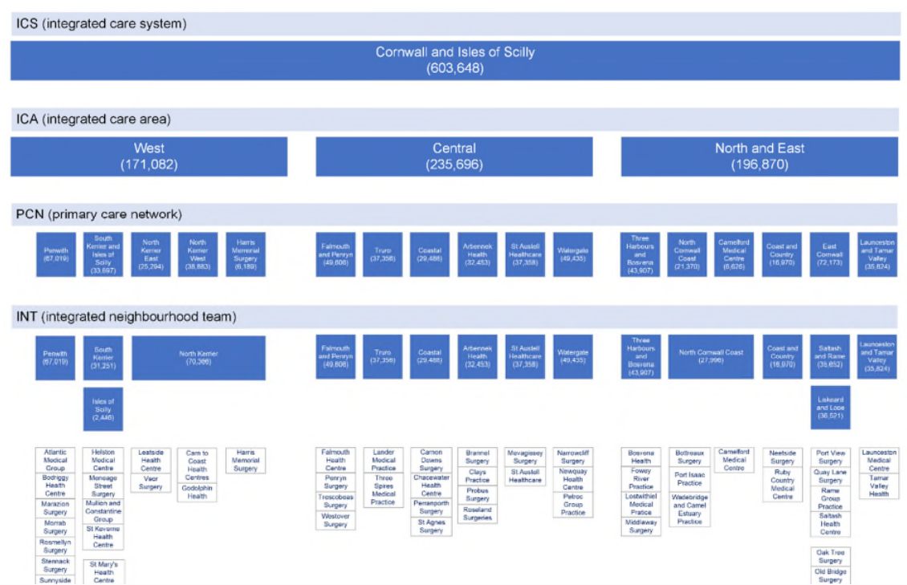
Cornwall example

Slide 11
Central Cornwall’s ambition for neighbourhood teams
Central ICA Senior Leadership Team
Primary Care
Primary Care
Primary Care
CFT teams
Social care
CFT teams
Social care
CFT teams
Social care
VCSE
VCSE
VCSE
Arbennek
Primary Care
Falmouth & Penryn
Primary Care
Truro
Primary Care
CFT teams
Social care
CFT teams
Social care
CFT teams
Social care
VCSE
VCSE
VCSE
Coastal
St Austell
Watergate
= Neighbourhood Leadership Team drawn from the partners supported by a Neighbourhood Facilitator

Slide 12
Roadmap for Devon’s Neighbourhood Health Services Summary
Q1
Set ICB commitment to neighbourhood health development
Q2
Establish all INTs based on agreed model
Identify 'wave 1' of INT development
Q3
Continue development of Wave 1 INTs
Establish frailty strategy in line with development of INTs
Q4
Y2
Y3
Evaluation and learning from Wave 1
2nd INT wave
3rd INT wave
Report on KPIs
Identify activity shift from acutes
Map Devon neighbourhoods on geography, assets, natural communities and PCNs
Agree the number and footprint of each neighbourhood and any other strategic intentions
Focus BI, Brave AI and improvement resource on Wave 1 INTs
Monitor KPIs

Slide 13
Questions for LCPs to consider in designing their neighbourhoods
What are the core principles to be central to this work?
What aims would the LCP look to Neighbourhoods to work towards?
What outcomes would the LCP look to Neighbourhoods to achieve?
What are the existing community assets? (link to existing mapping work)
What are the natural/traditional boundaries/groupings?
How do we currently collaborate?
How will neighbourhoods link to primary care services?– Or - what will the primary care component of Neighbourhoods be?
How will neighbourhoods link to mental health / learning disabilities / women’s, children’s and young people’s services? Or – what will the mental health / learning disabilities / women’s, children’s and young peoples’ component of Neighbourhoods be? And community and VCSE?
Who are our stakeholders and how will they be involved in the development process?
How will we share data / develop single patient record?
How will our governance work?
How will we make best use of resources? (reducing duplication of activity)
Any diagrammatic representation of neighbourhoods as developed by the LCP
What other guidance/support and direction at a Devon system level would be helpful in determining the Devon approach?

