Slide 1
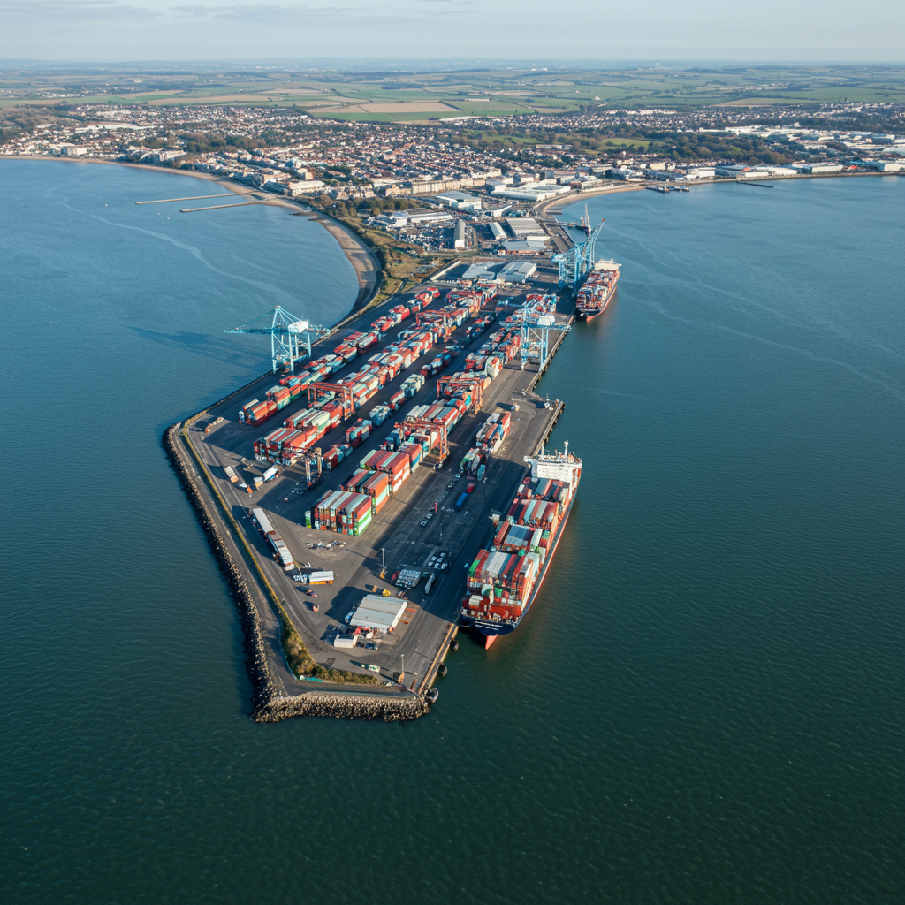

Rising with the Tide:
Improving Coastal Health
in England
The Coastal Navigators’
Network Prospectus
The First 8 Months
April 2025

Slide 2
Acknowledgements
We would like to thank Professor Sir Chris Whitty, Chief Medical Officer and his staff for their commitment to improving the health and wellbeing of coastal communities and in their ongoing support for the work of the Coastal Navigators’ Network (CNN).
We would like to thank Sir Chris Whitty, Chief Medical Officer and his staff for their commitment to improving the health and wellbeing of coastal communities and in their ongoing support for the work of the Coastal navigators Network.
We are also very grateful to NHS England and Suffolk and North East Essex ICB for their sponsorship and guidance in developing the Coastal Navigators’ Network, in particular Professor Bola Owolabi, Director of Health Inequalities at NHSE and Dr Ed Garratt OBE, CEO SNEE ICB.
We are also very grateful to NHS England and Suffolk and North East Essex ICB for their sponsorship and guidance in developing the Coastal Navigators Network, in particular Professor Bola Owolabi, Director – Health Inequalities at NHS England and Dr Ed Garratt OBE, CEO SNEE ICB.
We would like to thank each of the Senior Responsible Officers from the six leading network Integrated Care Boards:
Louise Hardwick, Deputy Director of Partnerships, Connect Lead Ipswich and East Suffolk Alliance, and Maddie Baker-Woods, Ipswich & East Suffolk Alliance Director – Suffolk and North East Essex ICB
Vicki Lightfoot, System Retention Lead and Sandra Williamson, Director for Health Inequalities and Regional Collaboration – Lincolnshire ICB
Ellie Parson, Deputy Director of People – Dorset ICB
Ben Chandler, Senior Workforce Special Projects Manager – Norfolk and Waveney ICB
Jessica Mookherjee, Lead Public Health Consultant for Substance Misuse, Mental Health, Suicide Prevention and Well Being – Kent and Medway ICB and Megan Abbott-Weston, Public Health Specialist, Kent and Medway Suicide Prevention programme – Kent County Council
Ashley Scarff, Deputy Executive Managing Director – East Sussex and Brighton & Hove, Sussex ICB, and Dr Anna Merla, Consultant in Public Health – East Sussex County Council
We would like to thank each of the Senior Responsible Officers from the six leading network Integrated Care Boards:
Louise Hardwick, Deputy Director of Partnerships, Connect Lead Ipswich and East Suffolk Alliance, and Maddie Baker-Woods, Ipswich & East Suffolk Alliance Director – Suffolk and North East Essex ICB
Vicki Lightfoot, System Retention Lead and Sandra Wiliamson, Director for Health Inequalities and Regional Collaboration – Lincolnshire ICB
Ellie Parson, Deputy Director of People - Dorset ICB
Ben Chandler, Senior Workforce Special Projects Manager - Norfolk and Waveney ICB
Jessica Mookherjee, Lead Public Health Consultant for Substance Missuse, Mental Health, Suicide Prevention and Well Being - - Kent and Medway ICB and Megan Abbott-Weston, Public Health Specialist, Kent and Medway Suicide Prevention programme - Kent County Council
Dr Anna Merla, Consultant in Public Health, East Sussex County Council / Deputy Executive Managing Director - East Sussex and Brighton & Hove, Sussex ICB

Slide 3
Rising with the Tide:
Sections
(Click the below boxes on full screen mode to jump to section)
Foreword
Exec Summary
Case for Change
CNN First 8 Months: Phase 1
CNN: Next 12 Months

Slide 4
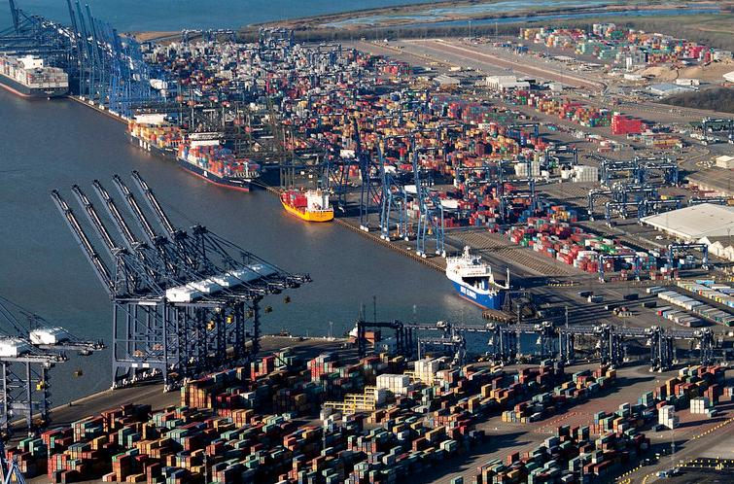


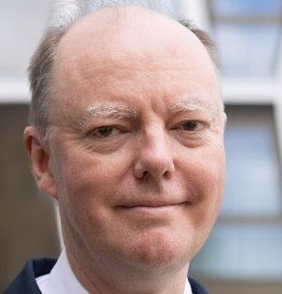
CMO Foreword
Whilst coastal communities are some of the most beautiful places in the country, they also have some of the worst health outcomes and lowest healthy life expectancy. Some of the reasons for this are relatively straightforward, for example poorer health in coastal communities is largely driven by age and deprivation. But some aspects of addressing this are more complex and challenging including the impact of housing, transport and employment. The granular data in this report clearly shows the sometimes stark differences that exist between coastal communities and their inland neighbours. On the positive side the data tells us what we need to focus on and what actions can be taken to reduce the amount of time people are living in poor health.
For example, in the coastal areas of Dorset, Norfolk and Lincolnshire there are very different patterns of ageing and health compared to urban areas. It is not just that there are more older people in coastal communities, there are more older people living longer in very poor health. It will be critical to have the right local workforce in these and similar areas to ensure that people can live independently for longer.
Alongside the additional health burdens that come with an ageing population our coastal communities are also seeing an increase in problems linked to socio-economic deprivation amongst younger age groups. In particular mental health problems including high rates of deaths by suicide and younger people involved in substance abuse and crime.
Professor Sir
Chris Whitty
Chief Medical Officer
for England

Slide 5
CMO Foreword
In Thanet we see how Real Time Suicide Surveillance data is being used to support a hyper-local response to reducing deaths by suicide and in Felixstowe, the Neighbourhood Health Team is working in collaboration with the voluntary sector to provide an innovative programme to inspire vulnerable younger people and instil them with confidence and resilience to avoid being involved with drugs and crime.
Access to good quality housing underpins many of these problems and in Sussex this is being directly linked to support in finding employment so that people can move from temporary, often poor accommodation into sustainable housing.
The six programmes in this report are highlighting issues that are of concern to all our coastal communities and are demonstrating what can be done to address these problems in realistic ways.
The challenges that our coastal communities face are significant, but they are not insoluble. It is important to think and act beyond health alone and encompass a wider perspective of population health that includes the socio-economic drivers on the coast such as insecure housing, transport and employment. We need to act across agencies and sectors in ways that combine primary and secondary prevention with social interventions. Now is the right time to renew the national focus on our coast as a key part of reducing health and economic inequalities for the country as a whole.
Professor Sir
Chris Whitty
Chief Medical Officer
for England

Slide 6
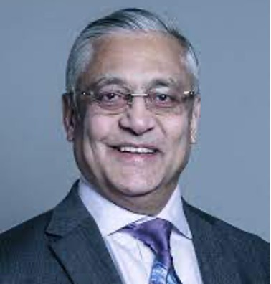
Chair’s Note – Why Economic Inactivity
Click here for YouTube link to full reading by our Chair (Fullscreen Mode Only)
The Coastal Navigators’ Network was established in 2024 as a community of practice between six ICBs and NHS England, with a shared goal of reducing health inequalities on the coast.
For this first prospectus, we’ve chosen to focus on economic inactivity.
While we fully recognise it’s only one piece of the puzzle, it is — by some margin — the most dominant thread across our work so far. Crucially, it is also the opportunity that can begin to solve itself.
Coastal communities haven’t ended up in this position by accident. Many were once thriving seaside economies, built on tourism and seasonal work. As those patterns changed, they left behind communities with deep roots but fewer routes into new opportunities — especially in energy, care, and the digital economy, where non-office roles are now growing alongside more traditional sectors like tourism and hospitality.
Put simply: we have employers with vacancies and people without jobs. And we know that if you're unemployed, you're five times more likely to be in poor health. So from a strategic perspective, this is where we can have the biggest impact — particularly by building inclusive pathways into essential roles like health and care, which themselves face chronic workforce shortages.
It’s also the case that in all six areas, employment — or routes into employment — formed a key part of each project’s prevention or recovery strategy. Whether it’s tackling insecure housing in Bexhill, youth substance misuse in Felixstowe, or suicide prevention in Thanet, employment isn’t separate from health — it’s embedded within it.
The Professor Lord Patel of Bradford OBE
CNN Chair
So it makes sense to begin our shared learning here: how coastal communities can support each other to avoid reinventing the wheel, and instead share what works. It also makes sense operationally. With initiatives like Connect to Work gaining traction — and local flexibility and targeted resources on offer — there is a real window to show that coastal areas are ready to go further, faster.
However, the risk is that the levers for many of these new funding opportunities sit inland — often with Combined Authorities that do not include coastal voices. That’s why the visibility of CNN and its members matters. Together, we can ensure that these 55 towns are recognised and resourced — not overlooked.
Focusing on economic inactivity eight months into the journey gives us a strong foundation. But we know it run in parallel with changes in housing (which often moves in lockstep with employment and recovery), in care tech (which can modernise delivery and workforce models in remote locations), and in creating better packages to attract and retain health and care staff in coastal areas.
We see CNN’s role as helping shape and share the solutions — not owning them. The examples in this prospectus are existing initiatives selected by the six ICB areas and their brilliant local partners, including local authorities and VCSE organisations for inclusion. Our job is to learn from them, amplify them, and help make connections so that good work doesn’t sit in silos.
Most of all, we want to recognise the individuals on the ground who are often spinning straw into gold. We hope this prospectus does justice to their work — and sets the stage for even more to come.
2/2

Slide 7
The Coastal Navigators’ Network was established in 2024 as a community of practice between six ICBs and NHS England, with a shared goal of reducing health inequalities on the coast.
For this first prospectus, we’ve chosen to focus on economic inactivity.
While we fully recognise it’s only one piece of the puzzle, it is — by some margin — the most dominant thread across our work so far. Crucially, it is also the opportunity that can begin to solve itself.
Coastal communities haven’t ended up in this position by accident. Many were once thriving seaside economies, built on tourism and seasonal work. As those patterns changed, they left behind communities with deep roots but fewer routes into new opportunities — especially in energy, care, and the digital economy, where non-office roles are now growing alongside more traditional sectors like tourism and hospitality.
Put simply: we have employers with vacancies and people without jobs. And we know that if you're unemployed, you're five times more likely to be in poor health. So from a strategic perspective, this is where we can have the biggest impact — particularly by building inclusive pathways into essential roles like health and care, which themselves face chronic workforce shortages.
It’s also the case that in all six areas, employment — or routes into employment — formed a key part of each project’s prevention or recovery strategy. Whether it’s tackling insecure housing in Bexhill, youth substance misuse in Felixstowe, or suicide prevention in Thanet, employment isn’t separate from health — it’s embedded within it.
1/2
Chair’s Note – Why Economic Inactivity
Click here for YouTube link to full reading by our Chair (Fullscreen Mode Only)
So it makes sense to begin our shared learning here: how coastal communities can support each other to avoid reinventing the wheel, and instead share what works. It also makes sense operationally. With initiatives like Connect to Work gaining traction — and local flexibility and targeted resources on offer — there is a real window to show that coastal areas are ready to go further, faster.
However, the risk is that the levers for many of these new funding opportunities sit inland — often with Combined Authorities that do not include coastal voices. That’s why the visibility of CNN and its members matters. Together, we can ensure that these 55 towns are recognised and resourced — not overlooked.
Focusing on economic inactivity eight months into the journey gives us a strong foundation. But we know it runs in parallel with changes in housing (which often moves in lockstep with employment and recovery), in care tech (which can modernise delivery and workforce models in remote locations), and in creating better packages to attract and retain health and care staff in coastal areas.
We see CNN’s role as helping shape and share the solutions — not owning them. The examples in this prospectus are existing initiatives selected by the six ICB areas and their brilliant local partners, including local authorities and VCSE organisations for inclusion. Our job is to learn from them, amplify them, and help make connections so that good work doesn’t sit in silos.
Most of all, we want to recognise the individuals on the ground who are often spinning straw into gold. We hope this prospectus does justice to their work — and sets the stage for even more to come.
The Professor Lord Patel of Bradford OBE
CNN Chair

Slide 8

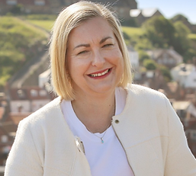
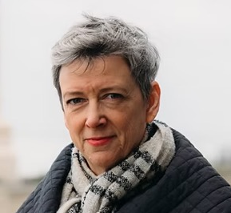
APPG Endorsement: Bridging Health & Economic Gaps
“The All-Party Parliamentary Group for Coastal Communities recognises the vital work of the Coastal Navigators’ Network in helping to bridge the gap between health and the economy across our coastal areas.
CNN has brought a fresh clarity to what’s going wrong in many coastal places and, crucially, what can be done about it – particularly in tackling economic inactivity and the long-standing disconnect between national policy and coastal realities.
We value their practical focus, their momentum, and their commitment to action. As an APPG, we are keen to champion the solutions outlined in this prospectus at the highest level and support the cross-departmental approach being recommended.
We hope all coastal areas will have the opportunity to contribute to and benefit from the Coastal Navigators’ Network as it develops – it is a critical step in ensuring coastal communities are no longer left behind.”
“
“
Co-Chair,
Alison Hume MP,
Scarborough and Whitby
Co-Chair,
Polly Billington MP,
East Thanet

Slide 9
Rising with the Tide:
Sections
(Click the below boxes on full screen mode to jump to section)
Foreword
Exec Summary
Case for Change
CNN First 8 Months: Phase 1
CNN: Next 12 Months

Slide 10
Exec Summary
The evidence in the report is drawn from three sources:
1
Learning from the Community of Practice across the six locations in the CNN including local data and intelligence and stakeholder feedback
Learning from the Community of Practice across the six locations in the CNN including local data and intelligence and stakeholder feedback
2
Analysis of a range of data from the ONS on 55 coastal towns that all score high on deprivation and have a mixture of employment to resident ratios
Analysis of a range of data from the ONS on 55 coastal towns that all score high on deprivation and have a mixture of employment to resident ratios
3
Cost benefit analysis using an adapted version of the Treasury Green Book methods to demonstrate the potential return on investment for the coast
Cost benefit analysis using an adapted version of the Treasury Green Book methods to demonstrate the potential return on investment for the coast

Slide 11
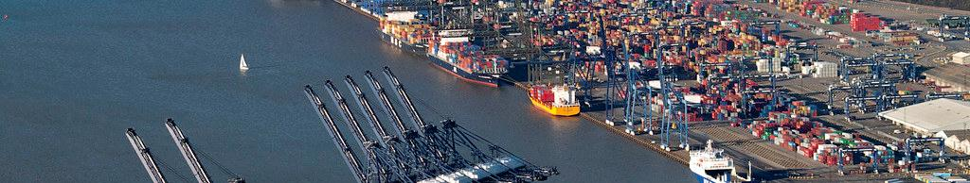
Exec Summary
The Case for Urgent Action
45.9%
>50%
£9.88B
Economic Inactivity
Long-term Sickness
Annual Cost
Working-age adults in coastal towns — more than double
the national average
Coastal residents inactive due to health conditions, compared to 36.2% nationally
Estimated total cost in lost productivity
The analysis of data for the 55 coastal towns shows the scale of coastal economic inactivity and the financial impact of lost productivity due to long-term sickness amongst coastal residents who are not working.

Slide 12
Exec Summary
The Case for Urgent Action
379,966
20.7%
Inactive Adults
National Share
£12.16B
Working-age adults in deprived coastal towns inactive due
to long-term sickness*
Disproportionate percentage of national economic inactivity
Annual Cost
Estimated cost of inaction
per year**
*(ONS & NOMIS data on 55 coastal towns)
**based on lost productivity, NHS costs, welfare, housing, social care etc.

Slide 13









The Scale of Coastal Economic Exclusion
Exec Summary
Coastal communities contribute over 14% of the UK’s economic inactivity, yet account for just 5–6% of measured productivity loss. This isn’t due to less severe problems — it’s because lower output per worker in these areas hides the real economic cost of poor health. Current metrics understate the true impact of health inequalities in coastal towns, risking underinvestment where it’s needed most.
Financial Impact
The cost of inaction
exceeds £12 billion annually –
driven by rising NHS demand, benefit dependency, and lost tax revenue.
NHS Burden
Coastal NHS systems face a disproportionate burden, accounting for 13.8 percentage points higher rates of economic inactivity due to long-term sickness while receiving 20.2% fewer resources to meet demand.
Human Cost
Over 379,966 people are out of work due to physical or mental health conditions in the 55 priority coastal communities.

Slide 14
Coastal Navigators’ Network:
Tackling Economic Inactivity in Coastal Towns
Exec Summary
Why This Matters
The Crisis
The Solution
England's coastal towns face a unique crisis of economic inactivity and poor health.
The Coastal Navigators’ Network (CNN) offers a targeted response.
These communities account for
14% of the entirety of England’s working age economic inactivity due to long-term sickness, and this will only increase over time. This in addition to an ageing coastal population living longer in poor health.
It provides capacity for ICBs, Local Government, Industry, Voluntary sector and DWP to collaborate on place-based interventions.

Slide 15
Coastal Navigators’ Network:
Tackling Economic Inactivity in Coastal Towns
Exec Summary
What's being addressed?
Why?
Limited employment pathways, staff dissatisfaction and high levels of turnover
Place-based collaboration can make a real difference in providing accessible career starting points and pathways for residents – attracting and retaining local talent in the locations
Investments from anchor employers not reaching local people. Residents don’t see investment making a difference to them
Anchor investments in coastal locations – energy, ports, health, defence, housing – can be transformational but only if these opportunities are accessible to the community
NHS has limited control over housing and wider determinants – partnership working essential
Constrained service provision

Slide 16






Coastal Navigators’ Network:
Scalable Initiatives from the 6 Programme Sites
Exec Summary
Locations*
Best Practice
Outcomes
Apollo Programme
Accessible Career Pathways
England's coastal towns face a unique crisis of economic inactivity and poor health
Apollo Programme
Accessible Career Pathways
England's coastal towns face a unique crisis of economic inactivity and poor health
Training Hub
Sustaining Youth Employment
Training Hub
Sustaining Youth Employment
Vocational Scholarships
Accessible Career Pathways
Vocational Scholarships
Accessible Career Pathways
The River Project
Engaging & Mentoring Young Residents
The River Project
Engaging and Mentoring Young Residents
The Coastal Navigators’ Network (CNN) offers a targeted response
The Coastal Navigators’ Network (CNN) offers a targeted response.
Moving on Up
Secure Housing & Employment
Moving on Up
Secure Housing
District Suicide Prevention Strategy
Mental Health & Wellbeing
District Suicide Prevention Strategy
Mental Health and Wellbeing
Notes:
*These refer to Integrated Care Board Systems: Norfolk & Waveney, Lincolnshire, Dorset, Suffolk & North East Essex, Sussex, Kent & Medway

Slide 17

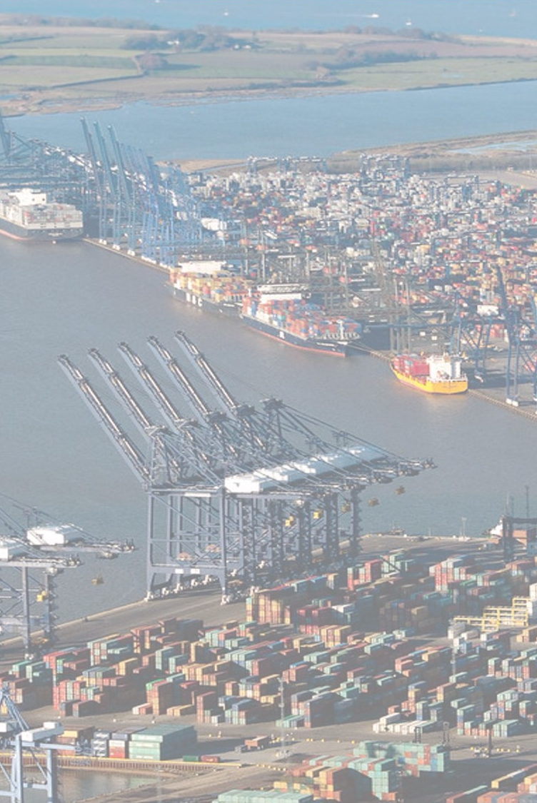





Strategic Fit – National
Exec Summary
Get Britain Working
Supports DWP goals to reduce economic inactivity
NHS Long-Term Workforce Plan
Tackles productivity and prevention challenges
Devolution and Local Growth
Empowers mayoral and combined authorities
Core20PLUS5
Addresses health inequalities in coastal populations
From Sickness to Prevention
Shortening the amount of time people spend in ill-health by
preventing illnesses before they happen

Slide 18
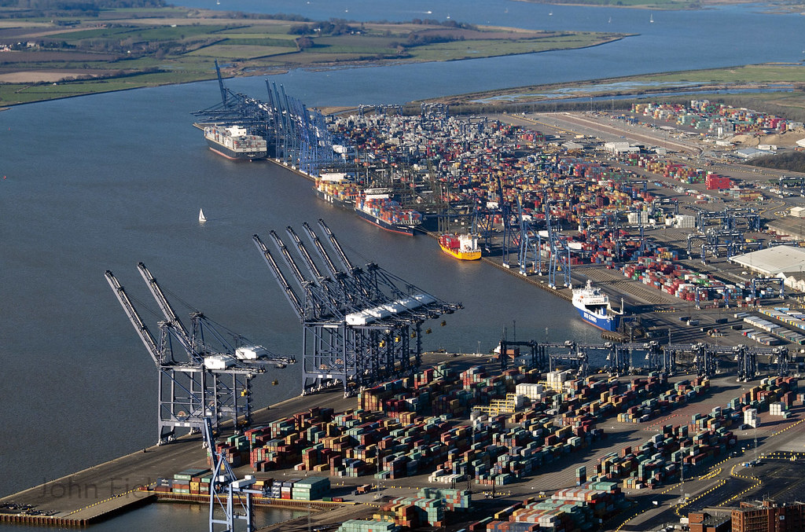
Our First 8 Months – Summary
Exec Summary
1
Formation of Community of Practice spanning six ICB systems to target areas of greatest need
2
Identified and scoped local projects that can be activated with the right support to address these
3
Produced costings for each area, showing the financial and human cost of inaction
4
Set up a cross-system learning network that can now be used to rapidly share solutions and scale what works
5
Connected the work to national levers, including departments and the APPG for Coastal Communities, to open up prioritisation and funding

Slide 19
The Case for a Tailored Approach Across the Coast
Exec Summary
The Case is Clear
Tackles root causes: poor health, transport, housing
Value for Money and Cost Effectiveness
Multi-agency co-investment: NHS, ICBs, LAs, DWP
£16,000
Hyper-local, co-produced delivery tailored to coastal needs
Cost of Inactivity
Preventative and rehabilitative integration with NHS
Estimated cost per inactive person annually
Builds delivery infrastructure, workforce and local capacity
£800
CNN Intervention
Projected cost per person for effective support
Traditional Employment Services
1.7:1
Focus on short-term job matching
cost-benefit ratio
Operates in silos (DWP or LA led)
The CNN Sustain Framework provides a stronger return than traditional employment interventions by addressing the upstream causes of inactivity. This enables local systems to reduce duplicated spending, pressure on NHS services, and inefficient welfare churn, despite coastal communities receiving disproportionately little targeted investment.
Uniform offer across geographies
Reactive approach to long-term sickness
Limited focus on system change

Slide 20
Rising with the Tide:
Sections
(Click the below boxes on full screen mode to jump to section)
Foreword
Exec Summary
Case for Change
CNN First 8 Months: Phase 1
CNN: Next 12 Months

Slide 21







Case for Change
Coastal-Specific Approach
Generic urban/rural solutions fail in coastal contexts. Targeted strategies address unique geographical and demographic factors.
Problem Definition / Coastal-Specific
Increasing health inequalities and socio-economic disparities will undermine national attempts to improve the median health and economic prosperity of the nation.
Cost of Doing Nothing
The combined costs of lost productivity, poor health and social pressures place an unsustainable burden on coastal economies.
National Policy Alignment
The prospectus seeks to ensure maximum impact by alignment with the government’s health and economic missions.

Slide 22


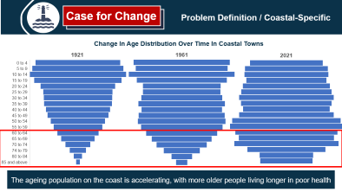
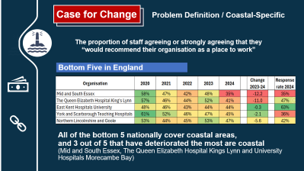
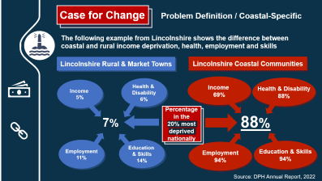
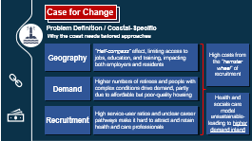
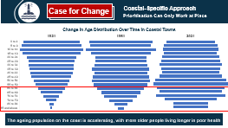
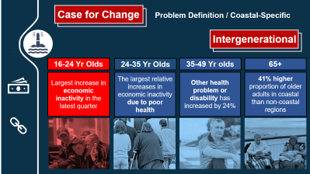
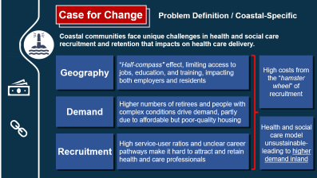
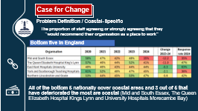
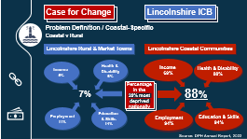
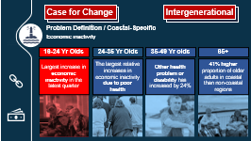
Case for Change
Problem Definition / Coastal-Specific
Generic urban/rural solutions fail in coastal contexts.
Targeted strategies address unique geographical and demographic factors.
Prioritisation
Rural v Coastal
Half-Compass Effect
Hamster Wheel of Recruitment
Economic Inactivity

Slide 23

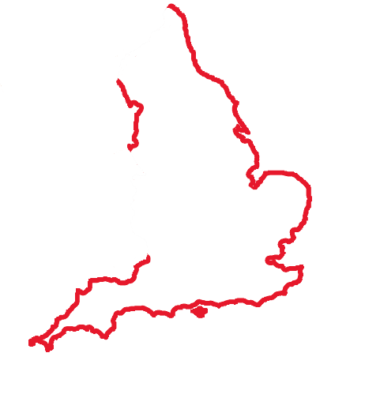

Case for Change
Problem Definition / Coastal-Specific
Coastal communities are small, but collectively are a large and significant priority national population group (18.5%) the near equivalent of the entire North West and North East regions combined
~ 10.4 million (approx. 18.5% of England’s population)
North West (7.42m) + North East (2.65m) = ~10.07 million

Slide 24

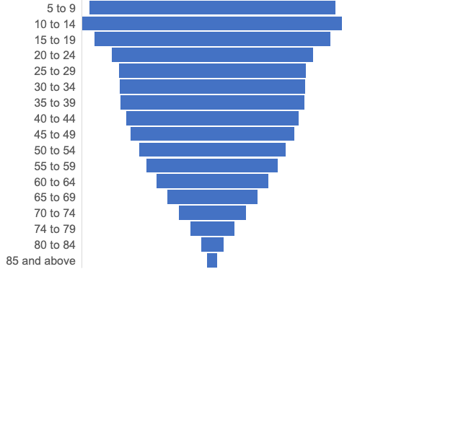

Case for Change
Problem Definition / Coastal-Specific
Change In Age Distribution Over Time In Coastal Towns
1921
The ageing population on the coast is accelerating, with more older people living longer in poor health

Slide 25
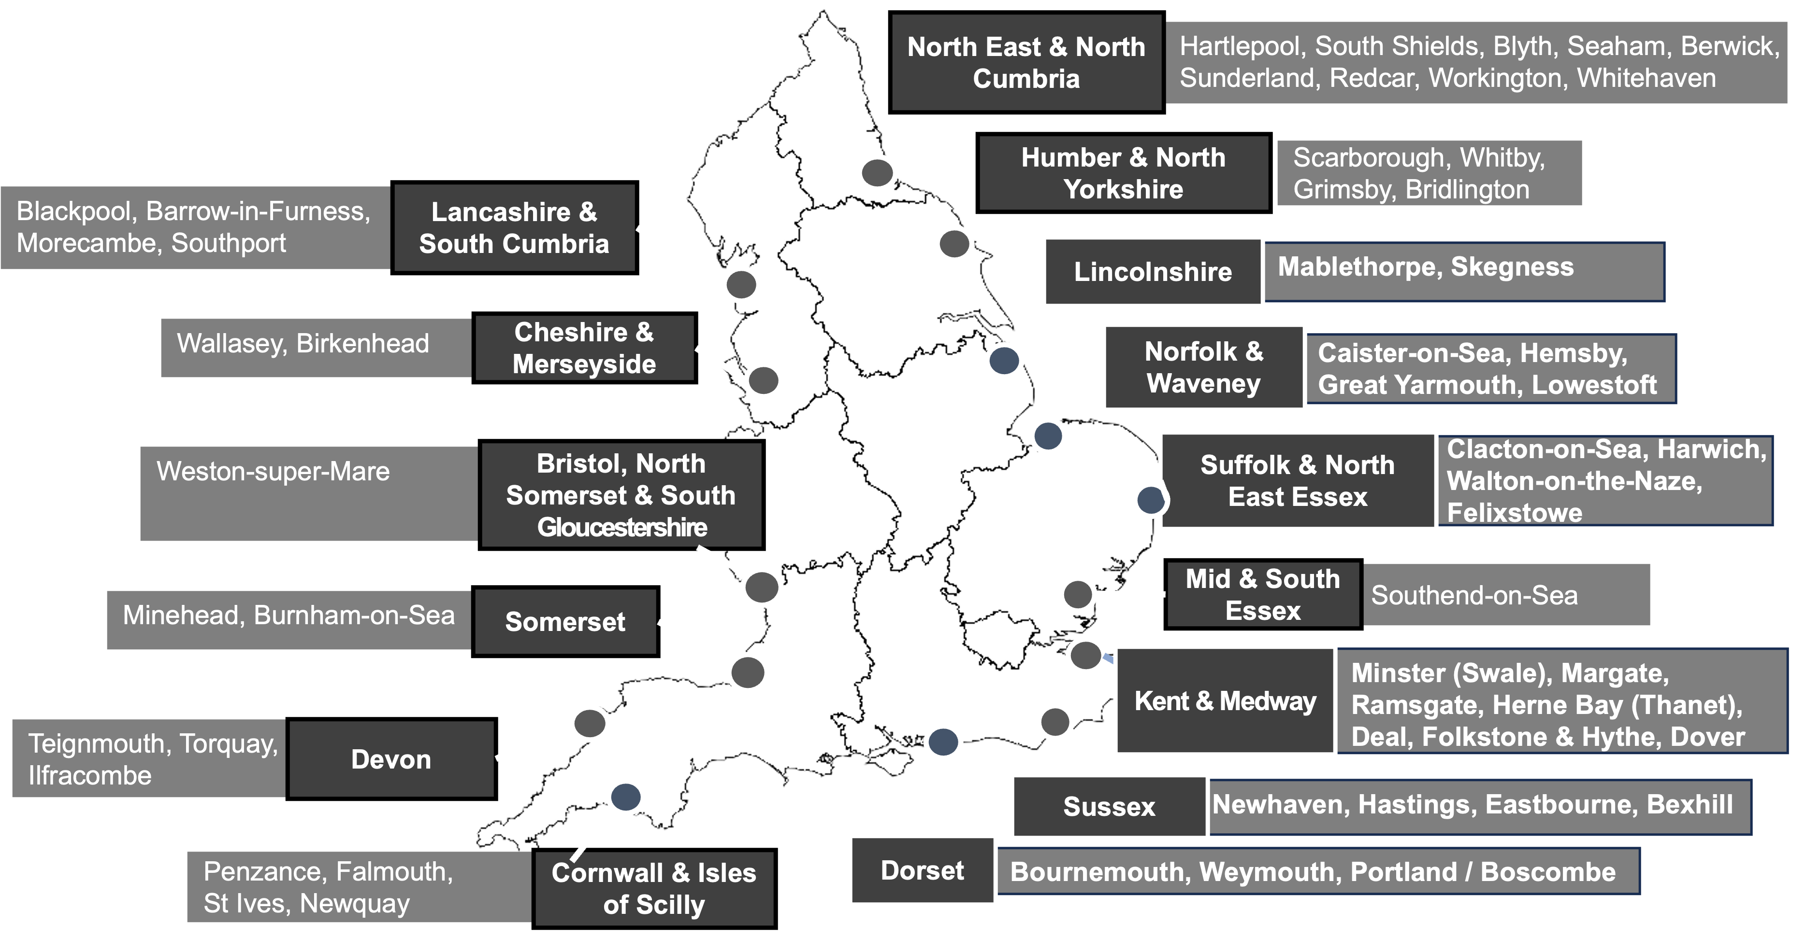
Case for Change
Problem Definition / Coastal-Specific
The prospectus contains analysis of 55 of the most deprived coastal towns
The towns were selected using the ONS categorisations of income deprivation and differing ratios of residents to job density
The towns were selected using the ONS categorisations of income deprivation and differing ratios of residents to job density
The analysis provides comparison of variables including economic inactivity and related health and social barriers to better employment and skills
The analysis provides comparison of variables including economic inactivity and related health and social barriers to better employment and skills
The mixture of different coastal towns enables assumptions to be made about the costs and benefits of action for all coastal communities
The mixture of different coastal towns enables assumptions to be made about the costs and benefits of action for all coastal communities

Slide 26
Case for Change
Problem Definition / Coastal-Specific
Seasonal Work
Limited Opportunities
NHS Employers
Many coastal jobs are seasonal, leading to income instability and lack of benefits
Geographic isolation and limited diversification of industries restrict employment options
NHS Trusts serving coastal areas feature highly in the worse rated places to work by staff
Lack of Skills
Economic inactivity
Skill gaps and lack of physical access to training and apprenticeships that are available on the coast hinders workforce participation
People not working due to long-term sickness in coastal towns is
13.8 percentage points higher than England

Slide 27
Case for Change
Problem Definition / Coastal-Specific
The following example from Lincolnshire shows the difference between coastal and rural income deprivation, health, employment and skills
Lincolnshire Rural & Market Towns
Lincolnshire Coastal Communities
Income
5%
Health &
Disability
6%
Income
69%
Health & Disability
88%
Percentage in the
20% most deprived nationally
7%
88%
Employment
11%
Education
& Skills
14%
Employment
94%
Education & Skills
94%
Source: DPH Annual Report, 2022

Slide 28
Case for Change
Problem Definition / Coastal-Specific
Coastal communities face unique challenges in health and social care recruitment and retention that impacts on health care delivery.
Geography
“Half-compass" effect, limiting access to jobs, education, and training, impacting both employers and residents
High costs from the “hamster wheel” of recruitment
Geography
“Half-compass" effect, limiting access to jobs, education, and training, impacting both employers and residents.
High costs from the “hamster wheel” of recruitment
Demand
Higher numbers of retirees and people with complex conditions drive demand, partly due to affordable but poor-quality housing
Demand
Higher numbers of retirees and people with complex conditions drive demand, partly due to affordable but poor-quality housing
Health and social care model unsustainable- leading to higher demand inland
Health and socials care model unsustainable- leading to higher demand inland
Recruitment
High service-user ratios and unclear career pathways make it hard to attract and retain health and care professionals
Recruitment
High service-user ratios and unclear career pathways make it hard to attract and retain health and care professionals

Slide 29
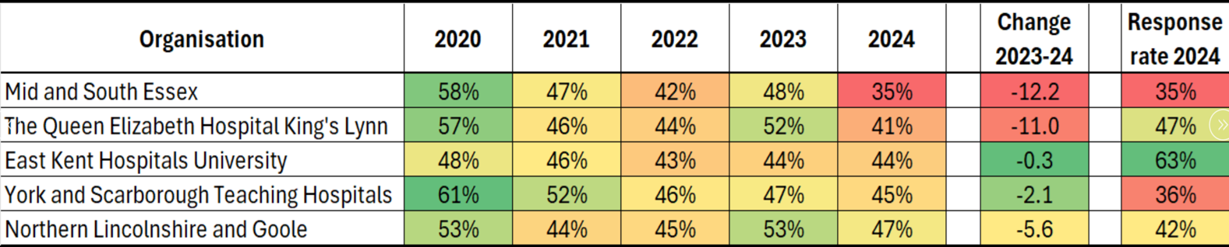
The proportion of staff agreeing or strongly agreeing that they “would recommend their organisation as a place to work”
Case for Change
Problem Definition / Coastal-Specific
Bottom Five in England
All of the bottom 5 nationally cover coastal areas,
and 3 out of 5 that have deteriorated the most are coastal
(Mid and South Essex, The Queen Elizabeth Hospital Kings Lynn and University Hospitals Morecambe Bay)

Slide 30
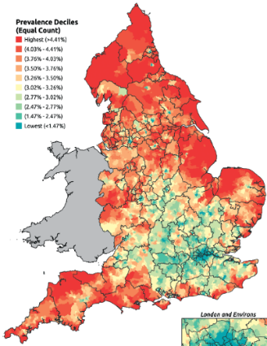
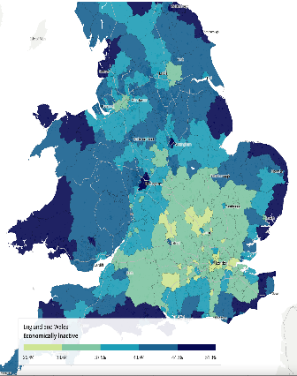
Case for Change
Problem Definition / Coastal-Specific
The coastal pattern of economic inactivity mirrors that for health inequalities
Chronic Heart Disease 17.8% more
Economic inactivity 45.9%
Chronic Heart Disease 17.8% more
Compared to national prevalence of 3.16%
Compared to national prevalence of 22%
Compared to national prevalence of 3.16%
CMO Annual Report, 2021
ONS, November 2023

Slide 31
Case for Change
Problem Definition / Coastal-Specific
The scale of coastal economic inactivity is significant and proportionately exceeds that for similar inland towns
7% of England’s working age population live in the 55 most deprived coastal towns
= 2.2 million people; of these:
254,000
500,000
1 million
11% have never worked / are long-term unemployed
Never worked/Long Term Unemployed
22% have no qualifications
No qualifications
45.9% are economically
inactive
Economically inactive

Slide 32
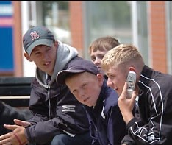
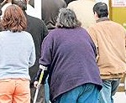

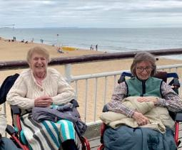
Case for Change
Problem Definition / Coastal-Specific
Intergenerational
16-24 Yr Olds
24-35 Yr Olds
35-49 Yr olds
65+
Largest increase in economic inactivity in the latest quarter
The largest relative increases in economic inactivity due to poor health
Other health problem or disability has increased by 24%
41% higher proportion of older adults in coastal than non-coastal regions

Slide 33











Case for Change
Cost of Doing Nothing
Economic Impact
Lost tax revenue and reduced local spending
Healthcare Burden
Higher NHS expenditure on preventable admissions
Social Care Pressure
Increased demand due to ageing and complex needs
Welfare Dependency
Greater reliance on benefits systems
Failing to address these intertwined challenges leads to rising public costs and worsening outcomes across multiple sectors. The economic impact extends beyond direct healthcare costs to include reduced business productivity and diminished community resilience.
Without intervention, these costs will continue to escalate, creating an unsustainable burden on public services and further entrenching health and economic inequalities in coastal communities.

Slide 34
Case for Change
Cost of Doing Nothing
The combined costs of lost productivity, poor health and social pressures place an unsustainable burden on coastal economies.
The cost of inaction is significant. Recent estimates suggest that failure to address economic inactivity and poor health in these towns is costing the UK economy over £12 billion per year — through lost productivity, increased health and welfare costs, and missed tax revenues.
14%
Working-age people out of work due to long-term sickness in England live in these 55 coastal towns.
1/5
Working-age people out of work due to long-term sickness in the UK live in these 55 coastal towns.
£16K
The average cost per person of sickness-related inactivity—
including lost productivity, benefit dependency, and increased NHS use.
£16K
The average cost per person of sickness-related inactivity—
including lost productivity, benefit dependency, and increased NHS use
1/4
Around one quarter of healthcare costs nationally are linked to economic inactivity — with coastal communities among the hardest hit.
1/4
of total health system costs are linked to economic inactivity in coastal areas, where NHS pressures are most acute
£12.1
billion
The coastal fiscal burden, equivalent to more than the entire NHS England mental health budget.
£12.6
Billion
The coastal fiscal burden, equivalent to more than the entire NHS England mental health budget.

Slide 35








Case for Change
Cost of Doing Nothing
Health
Housing
Without intervention, estimated £0.91 billion in avoidable healthcare costs
£0.46 billion in
supported housing costs
Employment
Social Care
£9.88 billion lost productivity
£0.57 billion in additional
social care pressures
Skills
£0.34 billion lost
from low skills attainment

Slide 36




Case for Change
Cost of Doing Nothing
Excess NHS Costs: £910 Million Annually
Primary Care
£107.06 million annually
Acute/Emergency Care
£240.88 million annually
Community Services
£240.88 million annually
Non-elective Acute Admission
£321.18 million annually

Slide 37




Case for Change
Cost of Doing Nothing
Excess NHS Costs: £910 Million Annually
An estimated 379,966 working-age adults in the 55 coastal towns have chronic health conditions (13.8 percentage points higher than the national average).
These individuals incur per person annual health care costs of £1,197.48 – however this is 20.2% lower than for similar non-coastal populations, which equates to £229.8 million a year across the 55 coastal towns.
The cycle of under investment in coastal communities is unsustainable as the cost of long-term sickness, economic inactivity and an ageing population living longer in poor health continue to increase.

Slide 38
Case for Change
Cost of Doing Nothing
Excess Welfare Benefit Payments: £184 Million Annually
Additional Claimants
Cost of Universal Credit Claims
Approximately 102,590 additional benefit claimants across the 55 coastal towns economically inactive due to ill health or disability.
In the 55 towns the costs of universal credit claimants is £666.84 million each year.
Average Excess Cost
The additional cost per person for claimants with long-term health conditions is £897 per year.
Total Costs
The higher burden of long-term sickness in coastal towns results in an additional
£184 million in Universal Credit costs annually — much of which is due to the 13.8 percentage point difference in health-related inactivity.

Slide 39







Case for Change
Cost of Doing Nothing
Lost Tax Contributions: £132.5 Million Annually
Income Tax
National Insurance
Foregone income tax from potential earners
Lost NI contributions from
inactive workers
£1,500 Per Person
28,315 Potential Earners
Average annual tax/NI contribution foregone per person
Number of additional claimants lost due to health-related inactivity
The higher rate of long-term sickness in coastal towns costs the national economy an
additional £368 million per year in lost productivity and tax contribution, including £132.5 million due to the higher rate of claimants with a long-term sickness in the 55 coastal towns — on top of £184 million in extra Universal Credit spend

Slide 40






Case for Change
Increase Economic Participation
Increase Economic Participation
National Policy Alignment
(Get Britain Working, 2024)
The prospectus would accelerate the implementation of the Government’s health and economic missions
(Get Britain Working, 2024)
Achieve NHS Productivity Gains
Improve Population Health and Prevention
Achieve NHS Productivity Gains
Improve Population Health and Prevention
(Workforce Plan, 2023)
(NHS Long Term Plan)
(Workforce Plan, 2023)
(NHS Long-Term Plan)
Reduce Regional Inequality
Reducing Health Inequalities
Reduce Regional Inequality
Reducing Health Inequalities
(Devolution White Paper, 2024)
(Core20Plus5, 2022)
(Devolution White Paper, 2024)
(Core20Plus5, 2022)

Slide 41
Rising with the Tide:
Sections
(Click the below boxes on full screen mode to jump to section)
Foreword
Exec Summary
Case for Change
CNN First 8
Months: Phase 1
CNN: Next 12 Months

Slide 42
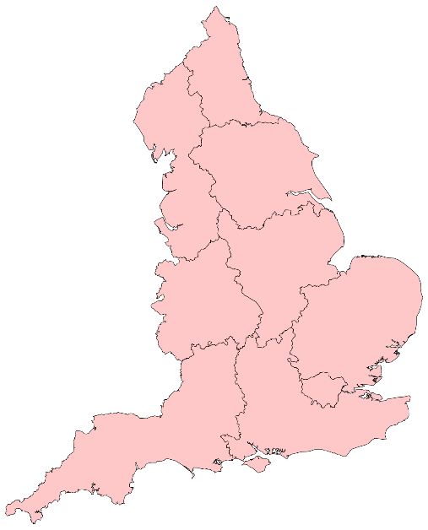
CNN First 8
Months: Phase 1

Slide 43
There are 16 Integrated Care Boards with Coastal Towns
North East & North Cumbria
Lancashire & South Cumbria
Humber & North Yorkshire
Cheshire & Merseyside
Lincolnshire
Bristol, North Somerset & South Gloucestershire
Norfolk & Waveney
Suffolk & North East Essex
Somerset
Mid & South Essex
Devon
Kent & Medway
Cornwall & Isles of Scilly
Dorset
Hampshire & Isle of Wight
Sussex

Slide 44

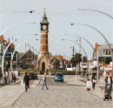


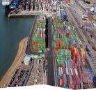
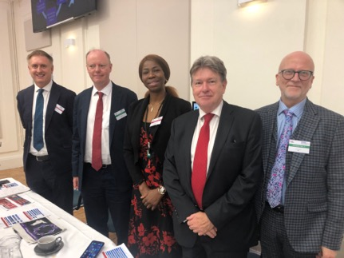

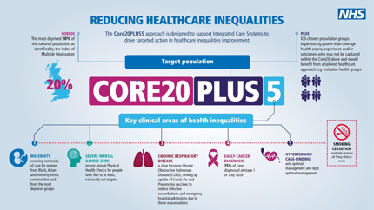
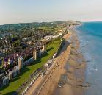
With 6 CNN Founder ICBs
CNN First 8
Months: Phase 1
Lincolnshire
Norfolk & Waveney
Skegness
Great Yarmouth
Suffolk & North East Essex
Dorset
Portland / Boscombe
Felixstowe
Kent & Medway
Thanet
Sussex
Bexhill

Slide 45

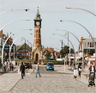

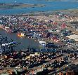
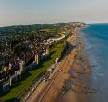

CNN Strategic Goals
1
Reduce health inequalities in coastal locations
2
Accelerate momentum and scalability towards planned or existing coastal projects
3
Through the project prospectus, set out the case for further targeted investment at local ICB and national levels towards the project
4
Identify opportunities for transferable learning from other ICB partners

Slide 46
CNN Objectives
Short Term
2024-2025
Activate plans for the 6 accelerator towns (12% of national target)
Greater emphasis at ICB level towards coastal population health
Through shared best practice more opportunities are seized by ICBs and partners

Slide 47
CNN Objectives
Evaluate the 6 accelerator sites
1
Reduce health inequalities in coastal locations
Short Term
2024-2025
2
Accelerate momentum and scalability towards planned or existing coastal projects.
Medium
2025-2027
Expand to 50% of national target
(25 Coastal Towns)
3
Through the project prospectus, set out the case for further targeted investment at local ICB and national levels towards the project.
A sustainable national approach tailored to coastal areas
4
Identify opportunities for transferable learning from other ICB partners.

Slide 48
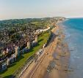
CNN Objectives
1
Reduce health inequalities in coastal locations
Short Term
2024-2025
2
Accelerate momentum and scalability towards planned or existing coastal projects.
Medium
2025-2027
100% of national target have an active plan
(55 Coastal Towns)
3
Through the project prospectus, set out the case for further targeted investment at local ICB and national levels towards the project.
Long
2027+
Worst case scenario projections are
never realised
4
Identify opportunities for transferable learning from other ICB partners.

Slide 49

CNN Project Focus:
Workforce
Prevention

Slide 50
Skills Deficit & Seasonal Employment
Skills Deficit and Seasonal Employment
Workforce
Pathways into
Primary Care
Pathways into
Primary Care
Retention in
Social Care
Retention in
Social Care
Youth Substance Use & Crime
Skills Deficit and Seasonal Employment
Prevention
Secure Housing & Employment
Pathways into
Primary Care
Suicide Prevention & Unemployment
Retention in
Social Care

Slide 51


Case Study Focus
Great Yarmouth: Maximising Employment Opportunities
“In the first 10 months,
270 people got into the
care sector as a result
of Apollo interventions — it’s not just about training, it’s about confidence and practical support”
East Coast College
Apollo Programme Cohort

Slide 52





Case Study Focus
Great Yarmouth: Maximising Employment Opportunities
Key Partners
Area Profile
26%
of people with no qualifications –
6th worst performing LA nationally
Areas of Focus
44.7%
economically inactive
Education Providers
Mentoring
^{44%}
average GCSE attainment – significantly below national average
Social Care Providers
Employment Opportunities
Local Trust
Training Opportunities
Opportunity:
Address challenge of poor attainment and seasonal employment through joining up neighbourhood initiatives and connecting them with new programmes e.g. seasonal apprenticeships model

Slide 53




Case Study Focus
Return on Investment
The Issue
Poor attainment levels leading to low-skilled workforce and a large economically inactive population exacerbated by seasonal roles
Evidence Base
Apollo – 274 participants into social care roles in first 10 months
Volunteer to Career – new pathways in employment
Educational investment into area including new university campus
Intervention
Join up existing programmes e.g. Apollo, which offer upskilling opportunities with new interventions to address seasonality of roles
ROI
Accessible career pathways, reduced reliance on seasonal jobs, and supported local health and social care recruitment, improving long-term workforce stability

Slide 54
Case Study Focus
Interventions
Apollo Programme
Innovative interventions to address recruitment and retention challenges in health and social care
3680 participants engaged so far
Offers solutions to high unemployment rates, poor attainment rates and seasonal roles
420
Courses completed to date
1774
Participants engaged in work experience
Supporting people new to health and care into first roles, people looking to retrain and change direction and employers seeking to upskill the workforce
440
Supported into employment
661
Employers engaged so far

Slide 55
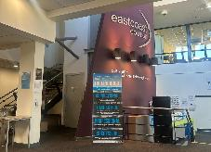
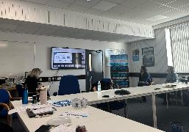




Site Visit
What’s making a difference?
The Apollo Project is a two-year workforce programme designed to address recruitment and retention challenges faced within the health and social care sector
The Apollo mode, personalised, embedded, and compassionate— has stood in stark contrast to generic provision
“[Previous employment support] made me feel worse. Apollo didn’t pressure me, they helped me breathe and start again”
“The Apollo Project is indeed here to launch people into a future they too may never have imagined. It is here to show that, no matter your background, your experience, or where you thought your career would take you, you can make a difference.”
“Volunteering was 100% the thing that helped me get a job.”
Proven that volunteering pathways can add value in primary care settings, and reduce organisational reluctance due to perception of resources required
Offers three-to-six-month volunteering opportunities with 1-2-1 mentoring throughout the programme and a range of opportunities to meet health professionals including, nurses, healthcare assistants and physiotherapists
“The programme has helped the Trust to further integrate volunteering into workforce strategies and aided the development of effective career pathways for volunteers”

Slide 56

Case Study Focus
Felixstowe: Young People, Drugs, and Crime
“There’s no employment focus. No decent pathway young people can believe in or see themselves in. They’re discounting themselves before they’ve even started.”
Voluntary Sector Chief Executive

Slide 57








Case Study Focus
Key Partners
Felixstowe: Young People, Drugs, and Crime
Boscombe & Portland:
Area Profile
2nd
highest rate of hospital admissions due to drug overdose in the East of England
Areas of Focus
Prevent
Schools
Education to Apprenticeship
29%
are Long-Term Sick/Disabled
Attract to service
Youth
Services
Skills – Level 2 Media Suite
40%
of drug service users are unemployed
Intervene/
Diversion
INT Social Prescribers
Pre-employment support
Opportunity:
To divert younger people at risk from substance misuse and crime into local employment and skills development

Slide 58
Case Study Focus
Return on Investment
The Issue
Felixstowe faces rising youth substance use, few jobs, and limited diversionary activities, fuelling antisocial behaviour
Evidence Base
Higher rate of admission to A&E for drug overdose
Increasing numbers of youth involved in county lines
Limited access to local early intervention
Intervention
Community-based drug prevention and diversion with Level Two Youth Hub and Mind, Body & Sea, alongside tailored job training initiatives
ROI
Improved social and health outcomes, reduce long-term economic inactivity (46.7%), and create pathways for at-risk youth to access employment and skills development, helping to address the third-highest drug overdose admissions rate in the East of England

Slide 59
Case Study Focus
Return on Investment
Integrated Neighbourhood Team
Patients recorded with alcohol and substance abuse: 3,716
Finance and activity measures
Young People aged 0 – 19 = (4,525)
PPPY – Total = £2,489 |  | 10% Reduction | 20% Reduction
 |  | Years 1 - 2 | Years 3 - 5
Acute elective | £600 | £540 | £480
Acute Non-elective | £787 | £709 | £630
GP Encounters | £332 | £299 | £266
Community | £183 | £165 | £147
Mental Health | £249 | £224 | £199
Social Care | £337 | £303 | £270
 |  | £2,240 PPPY | £1,992 PPPY
Total for population £9.3 million |  | Total cost saving year 5 £1.8 million
Alcohol and substance use
= 64 (1.4%)
Activity spend: £106,497 In total = 1.2%
£1,664 PPPY
Target:
Reduction of 50%
Cost Savings =
£53,248 Per year

Slide 60

Applied Across 55 Coastal Towns
Return on Investment
Integrated Neighbourhood Team
Patients recorded with alcohol and substance abuse: average = 10% which is 270,000
Finance and activity measures
Young People aged 0 – 19 = (428,604)
PPPY – Total = £2,489 |  | 10% Reduction | 20% Reduction
 |  | Years 1 - 2 | Years 3 - 5
Acute elective | £33,000 | £29,700 | £26,400
Acute Non-elective | £43,285 | £38,957 | £34,628
GP Encounters | £18,260 | £16,434 | £14,608
Community | £10,065 | £9,059 | £8,052
Mental Health | £13,695 | £12,326 | £10,956
Social Care | £18,535 | £16,682 | £14,828
 | £136,840 | £2,240 PPPY | £1,992 PPPY
Total for population £672 million |  | Total cost saving year 5 £134.5 million
Alcohol and substance use
= 6000 (1.4%)
Activity spend: £9.9M
In total = 1.2%
£1,664 PPPY
Target:
Reduction of 50%
Cost Savings =
£5 Million Per year

Slide 61
Case Study Focus
Interventions
Mind, Body and Sea / Level Two – River Project
Integrated Neighbourhood Team approach to vulnerable youth at risk of substance use and crime
800 young people engaged with Level Two youth service
Developing peer-based resilience through experience to navigate coastal waters on a Catamaran
Diverting from involvement in county lines
Exposure to multi-media skills and training
Supporting young people to explore new skills and change perspective about local opportunities and employment
Young people in small cohorts of
6 to do Mind, Body & Sea
Mentoring and crisis support

Slide 62

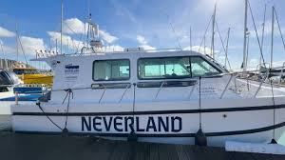




Site Visits
What’s making a difference?
“Our young people are excluded from the benefits and opportunities of living by the sea – the boat provides them with a new perspective of their home town.”
Taking small peer-based cohorts of vulnerable youth out on a boat to experience challenges, new skills and inspiration
“Neighbourhood health will only come from the ground up, building on local knowledge about the community”
“The nearest post 16 education is one and half hours away.”
The Integrated Neighbourhood Team is leading development of local connections and innovation
Level Two is providing accredited skills in a range of areas including multi-media and functional skills.
“We are seeing more younger people involved in drugs and county lines”
“Sustainability comes from anchor employer engagement – linking this directly to the neighbourhood health approach”
Clear, Hold, Build - launched in Felixstowe to tackle drugs, violence and anti-social behaviour

Slide 63
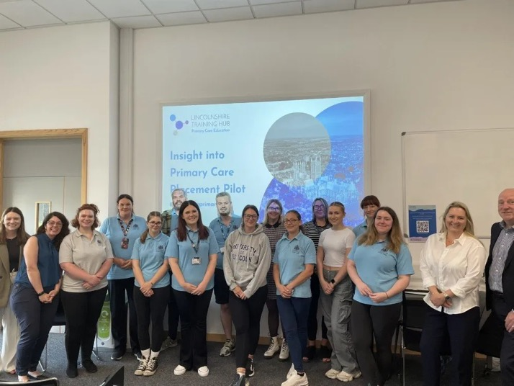
Case Study Focus
Skegness: Young People and unemployment
“When the
Community and the Primary Care Network comes together it works"
NHS Lincolnshire Training Hub

Slide 64







Case Study Focus
Skegness: Young People and unemployment
Key Partners
Boscombe & Portland:
Marisco
Medical
Practice
Area Profile
Under
30s
leaving coast as unable to train or gain employment locally
Areas of Focus
System
One
Workforce
Community and
PCN Coastal Academy
46.7%
economically inactive locally
Employers
Incentives
Increased local capacity
^{23%}
working age population have no qualification (12% nationally)
Community
Early access to care careers
Alternative to low paid seasonal jobs
Opportunity:
To provide more and better non-seasonal employment in health and care services for local younger people that will increase capacity for local interventions

Slide 65
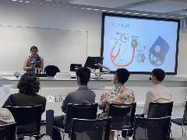



Case Study Focus
What’s making a difference?
“I have participated in many of your [Futures Programme] events over the past year and have just received a [university medical school] offer so I want to say thanks.”
Futures Programme – created to equip secondary school students with the tools to follow their aspirations of entering a healthcare career within the NHS
Primary Care Healthcare Cadet Programme – a supportive 15-month programme for people aged 17 – 24 that provides a nationally recognised level 2 qualification
Marisco
Medical
Practice
A 12-month support programme for Nurses or Nursing Associates within the first 2 years of working in General Practice
Career Start 25 is a flexible programme designed to fund and support your training and career development needs
“When the community and the PCN come together it works"
“Starting a new role comes with a heap of different emotions. Stepping directly into the corporate world is a huge step especially as a school leaver who has just finished sixth form, college or equivalent.”
12-month blended learning apprenticeship for health care assistant roles

Slide 66
Case Study Focus
Return on Investment
The Issue
High NEET rates, poor transport, and shortages in healthcare and eldercare impact coastal populations, limiting jobs and affecting health. 21.7% of working-age residents with no qualifications
Evidence Base
Lincolnshire Career Hub – over 12,500 students' career aspirations
Underutilised community transport
Lack of local workforce to fill PCN ARRS roles
Intervention
Recruiting younger people who are economically inactive due to health conditions and social barriers into primary care non-registered employment pathways in the coastal PCN
ROI
By addressing workforce shortages Lincolnshire ICB will expand pathways into primary healthcare roles, reduce reliance on seasonal jobs, and improve local economic resilience, helping to fill critical gaps in healthcare and eldercare delivery

Slide 67
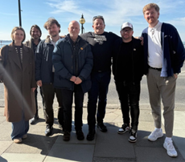
Case Study Focus
Thanet: Suicide Prevention Strategy
“Being one of the most deprived coastal areas, Thanet is absolutely the right place to do this —
but we need a hyperlocal, joined-up approach”
Social Enterprise Kent

Slide 68







Case Study Focus
Thanet: Suicide Prevention Strategy
Key Partners
Boscombe & Portland:
Area Profile
3rd
highest rate of completed suicide in the ICB
75%
of completed suicides in Kent and Medway are males
Areas of Focus
Older Males
Health inequalities dashboard
£22.5m
Employers
Priority needs assessment
cost of lost employment productivity Thanet
DWP & CVSE
Employment support
Opportunity:
To reduce the suicide risk amongst older males though earlier targeted interventions that also address unemployment/ redeployment

Slide 69
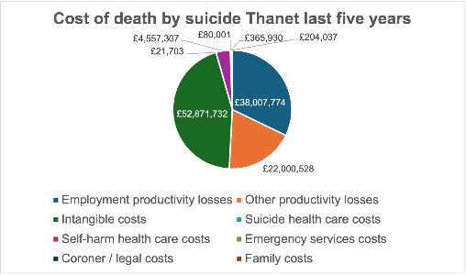
Case Study Focus
Thanet: Suicide Prevention Strategy
Cost of completed suicides for all 55 coastal towns
Employment productivity losses | £83,054,025
Other productivity losses | £48,075,227
Intangible costs | £115,534,524
Suicide health care costs | £47,424
Self-harm health care costs | £9,958,560
Emergency services costs | £174,818
Coroner / legal costs | £799,626
Family costs | £445,859
Total = £258.6 million per year
Opportunity:
To reduce the suicide risk amongst older males though earlier targeted interventions that also address unemployment/ redeployment

Slide 70
Case Study Focus
Return on Investment
The Issue
Thanet has the 3rd highest rate of completed suicides in the ICB and this is especially high for middle aged males
Evidence Base
Kent RTSS Suicide Dashboard
Local community agencies workshops
Intervention
To use targeted employment opportunities to alleviate risk factors behind increasing suicide rates amongst older males
ROI
Reduce the high rate of male deaths by suicide, which is the third-highest in the ICB, and address the underlying financial and emotional burdens on families, while improving pathways to employment and support for men

Slide 71





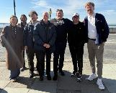

Site Visits
What’s making a difference?
“Our real-time suspected suicide system in collaboration with Kent police allows us to monitor trends and concerns but also deep-dive research into risk factors and particular cohorts”
District Suicide Prevention Strategy designed through a local multi-stakeholder approach which links 20+ local organisations together, drawing on the county wide strategy
Joint DWP Employment Programme with 50% Conversion into Paid Employment
“The key next step is getting the service users into employment focussed interventions”
Provides seed funding for community asset building; embedded within local HCP;
over 100 start ups within 2 years
Collective of County and District Council, Fire & Rescue, DWP, Police, Community partners delivering services to the most disadvantaged locally
“Just knowing it's there if needed really helps"
“Everywhere is different –
you need to meet people where they already go”
68% of service users come from the most deprived areas in Thanet
Reduced male prison suicide attempts from 60 a month to 26
BBI, KCC, TDC & Talk Club Team

Slide 72

Case Study Focus
Boscombe & Portland: Care Sector Pathways
“We’ve done the pilots. Dorset is littered with schemes that didn’t stick.
This time it needs to be designed with social care, not just for social care”
Social Care Provider

Slide 73





Case Study Focus
Boscombe & Portland: Care Sector Pathways
Boscombe: Pop. 11,000
Portland: Pop. 13,400
Boscombe & Portland:
#1
ageing population
(Oldest in UK)
43%
of under 30s leaving care jobs early
36.5%
very high social care workforce turnover
Areas of Focus
National
NHS
Scalable innovation
33%
of under-25s leave on the first day
Social Care
Employment support and career pathway opportunities
DWP
Skills and training
Opportunity:
Address ageing population demand through the lens of young people

Slide 74


Case Study Focus
What's making a difference?
Dorset Vocational Scholarship Programme
Four to six-week programmes focusing on a variety of roles with a guaranteed interview
at the end
Roadshows & awareness campaigns
Informal Conversations
Workplace Preparation
Application Support
Level 2 Qualification
Employment Checks
& Guidance
Career Guidance

Slide 75

Case Study Focus
What's making a difference?
Dorset Vocational Scholarship Programme
Four to six-week programmes focusing on a variety of roles with a guaranteed interview
at the end
Outcome:
8

Slide 76
Case Study Focus
Return on Investment
The Issue
Challenges in scaling social care for isolated coastal community with highest ageing population in UK
Evidence Base
Highly successful in small numbers
80% retention rate across all cohorts
Local people accessing entry-level roles
Intervention
Adapt and systemically support existing ICB led models for the needs of social care
ROI
Scaling up scholarship programmes will reduce Dorset’s high social care turnover rates, which currently see over 50% of under-25s leave within a year, and help meet the growing care needs of one of the UK’s oldest populations, ensuring a more sustainable

Slide 77



Site Visits
What’s making a difference?
“If you are passionate about a career in healthcare, then this would be an excellent place to start. It will give you all the skills you need to become a Healthcare Support Worker, and there are loads of different routes you can take from there.”
Vocational Scholarships - over 150 people supported into employment since inception in 2022, with
scholars progressing to Registered Nurse Degree Apprenticeships and Trainee Nurse Associate roles
Opportunity to study for a qualification to become a registered nurse whilst being paid with no tuition fees to pay – zero attrition rate over 2023
“A life changing opportunity to be able to embark on a new career, become qualified, get hands on practical experience while earning an affordable income to support my family”
Over 430 attendees and 40+ employment partners for a community event with on-the-day interviews for live vacancies, employment support and health checks
“It was so busy and we’ve had lots of great interactions. Have some people coming to our offices tomorrow so we can help them through the application process.”

Slide 78

Case Study Focus
Bexhill: Tackling Housing Insecurity Through Employment
“We’ve seen some really good cooperation across all organisations — churches, local authorities, charities — working together on housing and employment.”
Community organisation

Slide 79








Case Study Focus
Bexhill: Tackling Housing Insecurity Through Employment
Boscombe & Portland:
Area Profile
£1.9m
spend on temporary accommodation by Rother District Council 2023-34
Areas of Focus
£32.5k
average annual cost to the system of single homelessness
System
Holistic referral pathways
Employers
Incentives and support to keep people in employment
^{45%}
economically inactive
Community
Embedding integrated community teams
Opportunity:
Streamlining support for individuals at risk of homelessness through improved inter-agency coordination, data sharing and preventative measures such as employment and holistic care

Slide 80
Case Study Focus
Return on Investment
The Issue
Lack of consistent referral pathways for those at risk of homelessness who require support to remain in their homes e.g. physical and mental health conditions in addition to poor housing availability and support funding challenges
Evidence Base
223 people supported into employment and 60 people supported into permanent accommodation through Moving on Up programme
143 people experiencing or at risk of homelessness given employment, health and housing support through Live, Work, Thrive
Intervention
Linking new initiatives e.g. Connect to Work and existing knowledge from previous programmes to create clear, holistic pathways for support and address upstream factors which make people at risk of homelessness
ROI
Through strengthening system-wide activity to prevent homelessness and addressing upstream causes of homelessness, the number of people in Rother presenting as homeless (517) and the number of people in temporary accommodation (183) can be reduced

Slide 81




Case Study Focus
What’s making a difference?
Offers any East Sussex resident living in temporary housing or at risk of homelessness the opportunity to earn a living wage, access an apprenticeship or job with training, gain support from mentors and receive funding towards securing accommodation
“The benefits for the individual are many – health, secure housing and independence. It’s been really positive."
Supported 223 people into employment and 60 people from temporary accommodation into independent accommodation
East Sussex Floating Support Service provides flexible, personalised, short-term support including preventing homelessness, managing a tenancy, money management and accessing healthcare
“We stopped 6 families from becoming homeless, and when you think of the cost of 6 families – it’s a lot of savings.”
Skills and employment service offers a holistic service to people with low skills, to help them gain access to work, stay in their current employment and stay or move into long-term secure housing
Additional support available for employers to offer more opportunities including additional hours

Slide 82
Return on Investment over 5 years
Early Outline Across the 6 CNN programmes
£68 Million
£114 Million
£20 Million
£5 Million
£7 Million
£50 Million
A 50% increase in unemployed people gaining a job in health and social care
A 50% reduction in young people unemployed due to long-term sickness
A 50% reduction in early service leavers in the care sector
A 50% reduction in drug-related health care service utilisation
A 50% reduction in temporary housing
A 50% reduction in deaths by suicide
Skills
Pathways
Retention
Drug Use
Housing
Suicide

Slide 83
Rising with the Tide:
Sections
(Click the below boxes on full screen mode to jump to section)
Foreword
Exec Summary
Case for Change
CNN First 8 Months: Phase 1
CNN: Next 12 Months

Slide 84
Our First 8 Months – Summary
CNN: Next 12 Months
1
Formation of Community of Practice spanning six ICB systems to target areas of greatest need
2
Identified and scoped local projects that can be activated with the right support to address these
3
Produced costings for each area, showing the financial and human cost of inaction
4
Set up a cross-system learning network that can now be used to rapidly share solutions and scale what works
5
Connected the work to national levers, including departments and the APPG for Coastal Communities, to open up prioritisation and funding

Slide 85
Our First 8 Months
Month 8 – Month 20
1
Community of Practice
2
Local Projects
1
Implement & Sustain
Capacity for existing six sites to move from planning to delivery
3
Cost of Inaction
2
Expand & Scale
Support for up to ten new implementation sites
4
Cross-system Learning Network
5
National Levers

Slide 86

Month 8 – Month 20
CNN focus is now to sustain, expand and scale; the model is locally led and co-produced, aligning with national priorities including DWP's Get Britain Working, the NHS Long Term Workforce Plan, and Core20PLUS5.
Implement & Sustain
Capacity for existing six sites to move from planning to delivery
Expand & Scale
Support for up to ten new implementation sites
The approach is highly cost-effective at just £800 per person, compared to the £16,000 average cost of long-term sickness. A full-scale model could support up to 400,000 people, delivering an estimated annual return of £536 million, with a cost-benefit ratio of 1.7:1.

Slide 87




CNN: Scalable, Strategic, and Ready
Implement & Sustain
Coastal health challenges are driven mainly by social determinants
CNN shows ICBs and its partners can catalyse, initiate, and support local change
Long-term impact needs
shared ownership
across a wider coalition
Costs of change are lower in coastal areas — ROI is high
A shared investment mindset is essential
The CNN Sustain Framework provides three examples (recent, ongoing and a future example) of how sustained change can be made through national, place and community level partnerships
CNN Sustain Framework

Slide 88



The Sustain Framework : Four Pillars
CNN Sustain Framework
Drawing on insights from six leading coastal systems, the Sustain Framework provides a blueprint for breaking this cycle and embedding lasting improvement. It is built around four key principles:
1
Recognise Good Practice
2
A Shared Investment Mindset
Build on existing effective models in coastal communities
Avoiding silos and duplication by sustaining impact through shared investment that builds local capacity
3
Community Leadership
4
A Single Coastal Framework
Change led by local communities and employers
Joined-up planning and strategy across agencies, industry and partners in a common framework for lasting impact

Slide 89
CNN Sustain Framework
A Shared Investment Mindset
Port Developments, Windfarms, Nuclear Projects, Shipbuilding, Defence Projects, Construction & Technology, Housing Developments
Clinical Staff Teachers, GPs – Recruitment & Retention Supported
Example Resources
Connect to Work
Employers
UK Shared Prosperity Fund
External Investors
& Major Projects
Place Level
External Investment ->
Local Jobs for Local People
Partnerships
Local Planning
DWP Partnership
ICBs, PCNs, INTs
Supporting
Apprenticeships
Quality Jobs
Coaching
Mentoring
Skills to Employment Pathways
Workforce Pipeline for Care & Health
Community Level
Grassroots Support
SMEs, VCSE
Reduced Demand on Services
Positive Vision that Community
Trusts and Supports

Slide 90
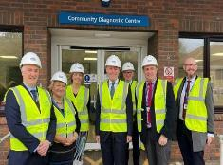
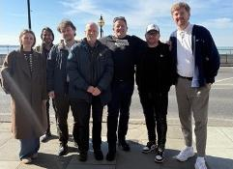

CNN Sustain Framework
Clacton Diagnostics Hub 2022-23
Thanet
Suicide Prevention Strategy
2024-Now
Felixstowe
Younger People at Risk of Drugs and Crime
Future Example
Making Change That Lasts –
Powered By Communities, Places And National Partners

Slide 91
CNN Sustain Framework
Clacton Diagnostics Hub 2022-23
MHCLG
DWP (Regional)
SNEE ICB
Resources
UK Community Renewal Fund
External Investors
& Major Projects
Beyond local – resources and inward investment
Place Level
Operational delivery
Benefits claimants down
East Suffolk and North East Essex NHS Foundation Trust
DWP (local)
All non-clinical staff roles filled in time for roll out
Community Level
Colchester Institute, Clacton Hospital
217 students economically active
50 actively in employment
Design, neighbourhood delivery and impact

Slide 92
CNN Sustain Framework
Thanet Suicide Prevention Strategy 2024-Now
National Suicide Prevention Strategy
Kent CC Suicide Prevention Strategy
Resources
OHID/DHSC
Anchor employers
External Investors
& Major Projects
Beyond local – resources and inward investment
Place Level
Operational delivery
Reduction in completed suicides
Partnerships
Margate Taskforce
DWP
Social Enterprise Kent
Employer and NHS productivity gains
Community Level
Town Shed, Talk Club
50% annual reduction = £11 million return to local economy
£430,000 saved in urgent and secondary health care costs
Design, neighbourhood delivery and impact

Slide 93
CNN Sustain Framework
SNEE Felixstowe Younger People At Risk Of Drugs & Crime Future Example
SNEE ICB
Suffolk Constabulary
Resources
(Indicative)
Home Office
Anchor Employers – E.g. The Ports
External Investors
& Major Projects
Beyond local – resources and inward investment
Place Level
Partnerships
Operational delivery
£53,000 annual savings to health service
Certified training
Diversion from county lines
Resilience and confidence
Integrated Neighbourhood Health team
Clear, Hold, Build
Pipeline to maritime employment opportunities
Community Level
Level two, Mind, Body & Sea, School
At risk youth engaged in small peer based cohorts
Skills and competency accelerators to employment
Design, neighbourhood delivery and impact

Slide 94

Month 8 – Month 20
Implement & Sustain
Capacity for existing six sites to move from planning to delivery
Expand & Scale
Support for up to ten new implementation sites

Slide 95





CNN: Scalable, Strategic, and Ready
Expand & Scale
Maximising the power of the Network – all 55 priority coastal communities are active and working together
Leveraging major transformational economic opportunities across the Energy, Logistics, Maritime, Tourism, Care Tech and Defence sector
Cross-departmental working partnership with the APPG for Coastal Communities to support strategic engagement with Transport, Skills, Education and Employment

Slide 96
CNN: Scalable, Strategic, and Ready
Expand & Scale
Coastal Priorities for Year 2
In addition to Economic Inactivity and Prevention – Year 2 will build solutions around three new priority actions that will make a significant impact for coastal communities
Places To Grow
Care Tech
Infrastructure
Strategies for holding on to and attracting talent and investment to coastal locations
Helping to support more coastal residents in their communities through transformative technology
Bringing health to the table in housebuilding, transport and place building

Slide 97
Expand & Scale
Working With Industry
Ports and Shipping
Nuclear and Green Energy
Creating pathways into logistics, maritime operations, customs and warehousing through partnerships with harbour authorities and shipping companies
Supporting training pipelines and inclusive employment through industry-academic partnerships (e.g. Sizewell C, Freeport East)
Tourism and Hospitality
Manufacturing and Logistics
Improving recruitment, workforce health, and progression routes for underemployed residents in seasonal economies
Developing workforce solutions particularly in Humber, Kent and North East coastal corridors
Each CNN ICB area will develop a local industry engagement plan with Chambers of Commerce, Mayoral and Combined Authorities, HEI/FE, DWP and Employers. This includes using the leverage of the CNN to contact all major employers for co-funded skills offers, supported employment programmes, and corporate social value commitments aligned with health and workforce inclusion.

Slide 98

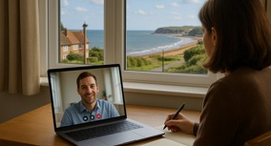
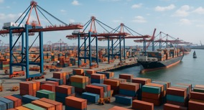

CNN: Scalable, Strategic, and Ready
Expand & Scale
A Smart Investment For Industry
a
Growth sectors are expanding – but risk missing local talent
Industries like green energy, logistics, and care-tech are growing in coastal zones — yet they often fail to connect with the local workforce. By building place-based pipelines, industry can meet its own labour needs more reliably.
b
Digital transformation makes coastal locations more viable
With more hybrid and remote roles, the traditional barriers of coastal geography (like poor transport) are less relevant. Industry can now tap into coastal talent without requiring daily commutes — making these areas even more attractive.
c
Local workforces are more stable and loyal
People who live locally are more likely to stay, invest in their community, and grow with the job — reducing churn and training costs. Coastal populations, when given a route in, are highly motivated to stay.
d
Breaking the cycle of relying on statutory services to 'fix' people
Investing in employment and skills early reduces long-term dependence on NHS, social care, and welfare. Industry becomes part of the solution, not just a beneficiary — shifting from reactive support to proactive partnership.

Slide 99
Expand & Scale
The CNN Framework For Working With New Locations
Getting Started
Where to focus?
Engagement and Co-Design
Activation
Who needs to be part of the plan for this to succeed?
Something to share and contribute with the network
Prevention
Co-designed pathway and delivery plan
Local Govt/ Combined Authority
Industry
Local NHS and care providers
Government Departments
PCC
VCSE/ Community
Care tech
Recruitment
Return on Investment case and the cost of doing nothing
Coastal career pathways
Shared Investment Framework
Something for the network to focus upon and support e.g: accelerating, scaling up, sustaining or activating interventions
Talent and employer attraction
High costs from the “hamster wheel” of recruitment
Housing and infrastructure
Connect through the CNN Year 2 Prospectus
Service transformation
The wider the network, the faster the impact

Slide 100
Expand & Scale
10 ICBs yet to join CNN represent a total of 30 coastal towns with the highest deprivation scores
30 coastal towns with the highest deprivation scores
Not currently engaged in CNN
Areas with no current CNN Involvement
North East & North Cumbria
Hartlepool, South Shields, Blyth, Seaham, Berwick, Sunderland, Redcar, Workington, Whitehaven
Humber & North Yorkshire
Scarborough, Whitby, Grimsby, Bridlington
Blackpool, Barrow-in-Furness, Morecambe, Southport
Lancashire & South Cumbria
Wallasey, Birkenhead
Cheshire & Merseyside
Weston-super-Mare
Bristol, North Somerset & South Gloucestershire
Mid & South Essex
Southend-on-Sea
Minehead, Burnham-on-Sea
Somerset
Teignmouth, Torquay, Ilfracombe
Devon
2025-26 Plan – active engagement with all 16 ICBs with projects in at least 15 of the 55 at risk locations
Cornwall & Isles of Scilly
Penzance, Falmouth,
St Ives, Newquay

Slide 101
Expand & Scale
Prospectus Scaled Up Across All Coastal Communities Over 10 Years
£1.4 Billion
£650 Million
£4 Billion
£550 Million
£1.4 Billion
£4.1 Billion
Addressing youth unemployment and drug-related challenges in all coastal areas could lead to a 25% reduction in drug-related hospital admissions, saving an estimated £200 million in A&E and treatment costs over 10 years. Additionally, reducing youth unemployment by 10% across these areas could add £1.2 billion to the local economies through increased workforce participation and reduced welfare dependency.
Expanding suicide prevention programmes to all coastal locations could reduce suicide rates by 15%, saving £150 million in associated health and social care costs over 10 years. Beyond this, the emotional and social benefits would lead to increased workforce participation and family stability, contributing £500 million in economic productivity gains.
Developing career pathways for underqualified and economically inactive individuals in coastal towns could bring 100,000 people back into the workforce, reducing economic inactivity by 10%. This could generate £4 billion in increased tax revenue and reduced welfare dependency over a decade while filling critical gaps in health and social care staffing.
Strengthening system-wide activity to reduce supported housing costs by 50% and prevent coastal homelessness by addressing upstream causes of insecure housing that would save £250 Million in local authority costs and reduce housing benefit claims by £300 Million due to people returning to employment.
Expanding vocational scholarship programmes to all coastal communities could address high turnover in social care roles, increasing retention by 50% and saving £1 billion in recruitment and training costs over the next decade. Meeting rising care demands more efficiently could generate £400 million in savings by reducing crisis care and hospital admissions.
Coordinating joined-up apprenticeship programmes across coastal regions could upskill 200,000 individuals, leading to a 15% increase in employment rates. This could generate £4.1 billion in economic activity over 10 years, while reducing reliance on seasonal employment and fostering long-term workforce stability.
Drug Use
Suicide Prevention
Career Pathways
Secure Housing
High Turnover
Coastal Apprenticeships

Slide 102
Cross-Departmental Collaboration
“The All-Party Parliamentary Group for Coastal Communities recognises the vital work of the Coastal Navigators’ Network in helping to bridge the gap between health and the economy across our coastal areas.
CNN has brought a fresh clarity to what’s going wrong in many coastal places and, crucially, what can be done about it – particularly in tackling economic inactivity and the long-standing disconnect between national policy and coastal realities.
We value their practical focus, their momentum, and their commitment to action. As an APPG, we are keen to champion the solutions outlined in this prospectus at the highest level and support the cross-departmental approach being recommended.
We hope all coastal areas will have the opportunity to contribute to and benefit from the Coastal Navigators’ Network as it develops – it is a critical step in ensuring coastal communities are no longer left behind.”
“
“
Co-Chair,
Alison Hume MP,
Scarborough and Whitby
Co-Chair,
Polly Billington MP,
East Thanet

Slide 103






Cross-Departmental Collaboration
CNN has been engaging with 6 Government Departments and national agencies
The evidence base from CNN will provide opportunities for national bodies to learn and test new interventions at scale
CNN has been engaging with 6 Government Departments and national agencies
The evidence base from CNN will provide opportunities for national bodies to learn and test new intervnetions at scale
Year 2 Goal for Cross-Departmental collaboration:
a sustainable national approach tailored to coastal areas
National

Slide 104
Where Do We Want To Be In 12 months?
1
Activating each of the existing 4 interventions – service transformation, employment, career pathways and prevention
1
2
Developing early-stage programmes around housing, care tech and talent attraction
2
3
System wide costing for what works and ROI and a national framework for delivery
3
4
Active employers including industry in each CNN location making a positive impact via a shared investment framework
4
5
Expansion from 6 to 15 priority coastal communities with all 16 ICBs involved
4

Slide 105
Making Change That Lasts –
Powered By Communities, Places and National Partners
Moving Forward Ideas into Action
Immediate Investment
Strategic Alignment
National Scale-Up
Shared investment to sustain existing sites and to support expansion to ten new implementation areas, including four with submitted expressions of interest.
CNN to work with the APPG for Coastal communities to amplify the specific needs of coastal locations as new health and economic policies begin to be implemented
Develop a comprehensive plan for roll-out across all 55 at-risk coastal locations, building on proven success and established partnerships
With targeted investment and political support, CNN can unlock opportunity, reduce the burden on public services, and drive long-term health and economic gains for the UK's coastal communities

Slide 106


CNN: Our Next Steps
1
Grow the CNN as a collective voice and community of practice
1
Recruit an additional 15 coastal towns to the CNN in the next year. To continue to provide platforms for cross-system learning
2
Promote understanding at national and regional level of coastal needs and aspirations, and the cost of doing nothing
2
Continue to link up with inland decision makers. Work with the APPG for Coastal Communities, Government departments and regional / national agencies e.g. OHID and combined authorities
3
Expand coastal career opportunities and sustain, scale up and raise awareness of them
3
Establish a coastal industry opportunity taskforce that supports CNN projects

Slide 107
Thank You
Thank you to our National, Place & Community Partners
To all the stakeholder organisations who have worked with the CNN team over the past few months to shape the Prospectus. Your insights, innovations and critique have been essential
Coastal APPG
NHSE
LGA Coastal SIG
DHSC
Coastal Communities Alliance
Business Board Network
DWP
BAE Systems
Skills for Care
DFE
Britain’s Energy Coast (BEC)
Transport East
MHCLG
University of Lincoln
DFT
ONS
University of Birmingham
Sussex Community Development Association
OHID

Slide 108
Thank You
Thank you to our National, Place & Community Partners
Great Yarmouth Borough Council
Agincare
Kent County Council
East Coast College
Partners in Care
Thanet District Council
Action Community Enterprises
Tricuro
Broadstairs Town Shed
East Sussex County Council
Citadel Project
Talk Club
Rother District Council
Housing Justice
Social Enterprise Kent
Skills for Learning
Victoria Medical Centre
Level Two
The Pelham, Bexhill
Dorset Care Alliance
Mind, Body & Sea
Hastings Borough Council
University of Essex
Felixstowe INT
Devon Foundation Trust
Coastal Tourism Academy
Felixstowe School

